Slide 1
Labcheck Next Generation Quick Start Guide
Troubleshooting Labels

Slide 2
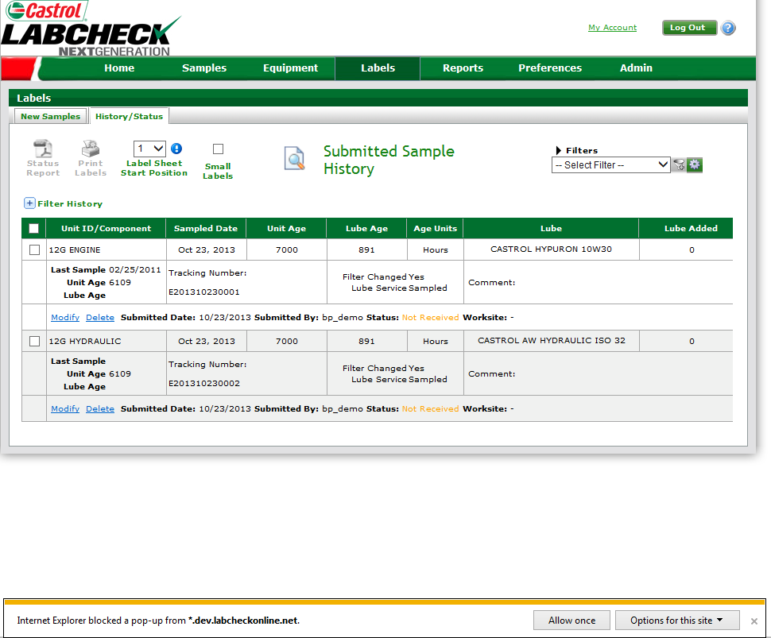
Internet Explorer Pop-up Blocker
If you see the message below when printing labels using Internet Explorer, your pop-up blockers are on.

Slide 3
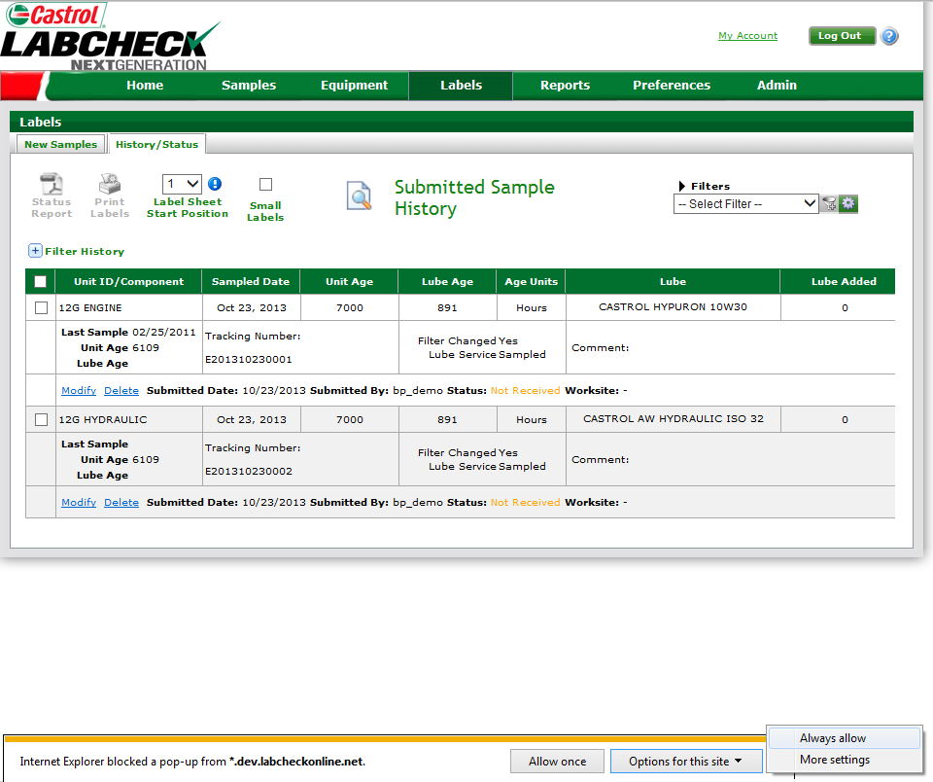
Internet Explorer Pop-up Blocker
To disable your pop-up blocker please follow the steps below:
Step One: Click on “Options for this site”
Step Two: Click on “Always allow”
Step Three: The page will then refresh, Reselect the check boxes next to your labels and hit the “Print Labels” button

Slide 4
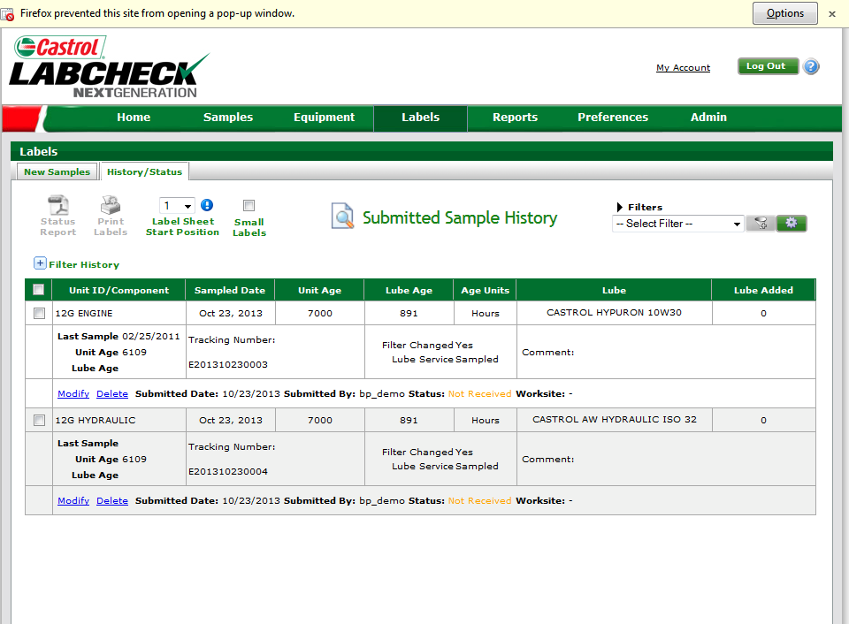
Mozilla Firefox Pop-up Blocker
If you see the message above when printing labels using Mozilla Firefox, your pop-up blockers are on.

Slide 5
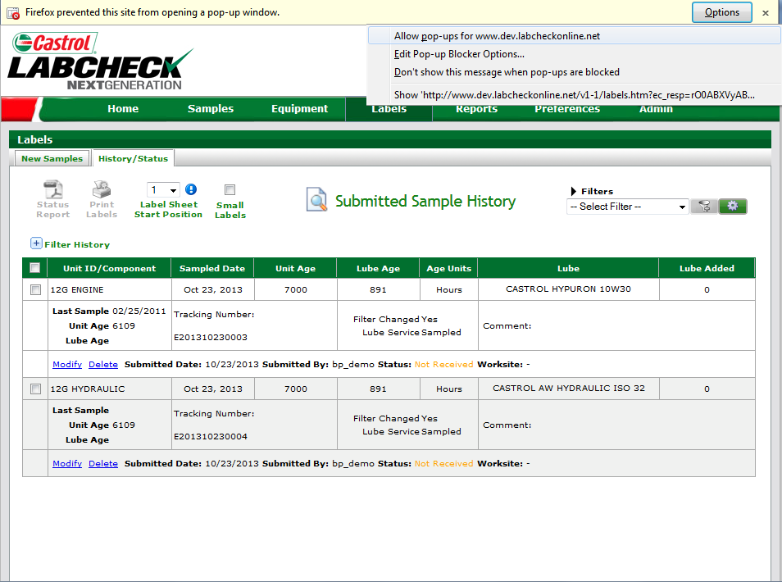
Mozilla Firefox Pop-up blocker
To disable your pop-up blocker please follow the steps below:
Step One: Click on options
Step Two: Click on “Allow pop-ups for www.labcheckonline.net”
Step Three: Reselect the check boxes next to your labels and hit the “Print Labels” button

Slide 6
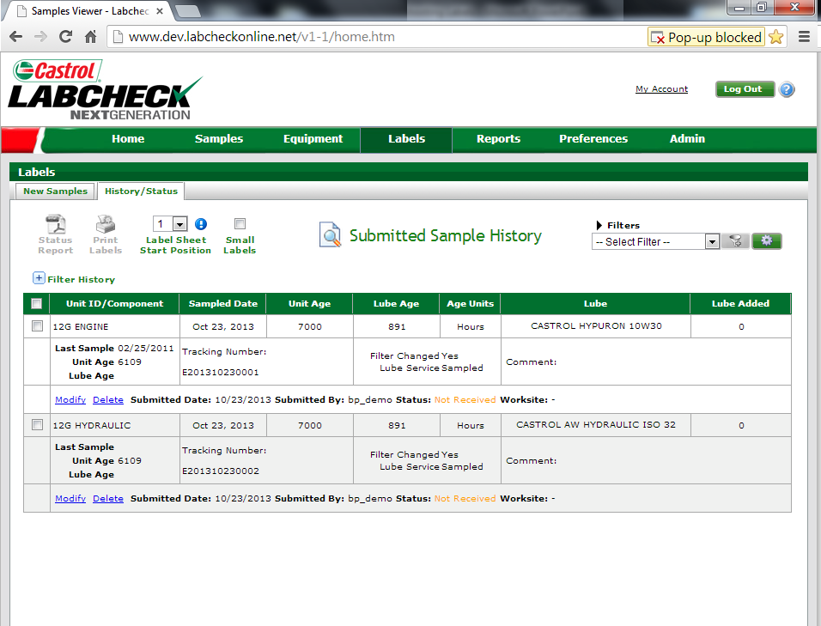
Google Chrome Pop-up Blocker
If you see the message above when printing labels using Google Chrome, your pop-up blockers are on.

Slide 7
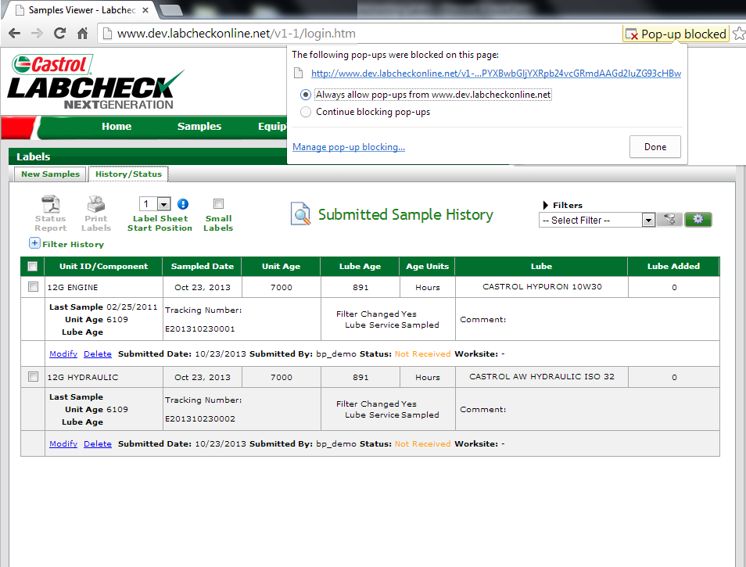
Google Chrome Pop-up Blocker
To disable your pop-up blocker please follow the steps below:
Step One: Click on the
icon
Step Two: Select the circle next to “Always allow pop-ups from www.labcheckonline.net”
Step Three: Click “Done”, reselect the check boxes next to your labels and hit the “Print Labels” button

Slide 8
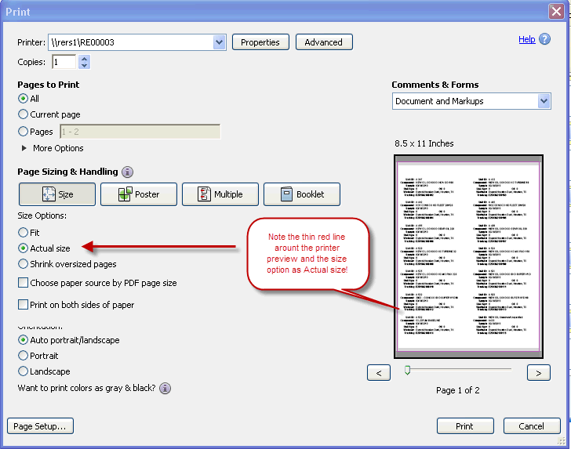
Aligning your labels
Before printing your labels, please be sure that your printer options match the screenshot below:

Slide 9
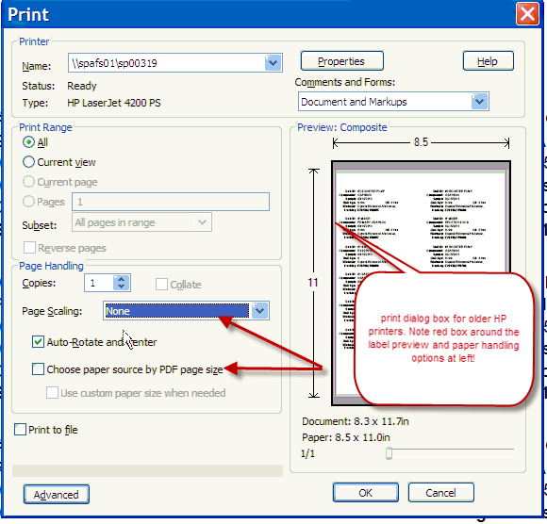
Aligning your labels
Deselect “Choose paper source by PDF paper page size" option and make sure the page scaling option is set to "None" as seen in screenshot below:

Slide 10
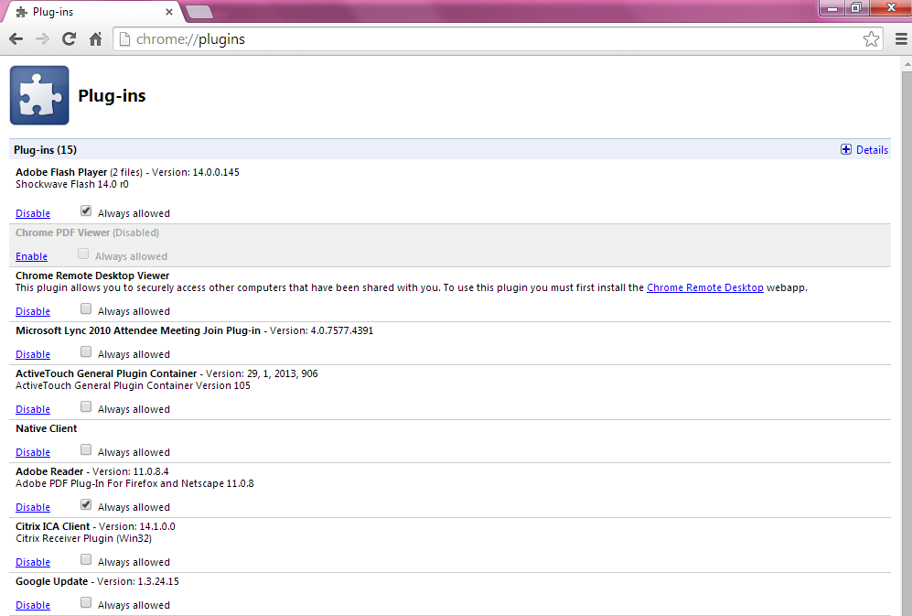
Aligning your Labels using Google Chrome
1.In the Chrome address bar, type chrome://plugins
2.Disable Chrome PDF Viewer.
3.Enable the Adobe Acrobat/ Adobe Reader plugin.

