Slide 1
Labcheck Next Generation Quick Start Guide
System Navigation

Slide 2
Navigating the Labcheck App
Help Button “?”: Provides Reference Guide for Each Page
Tabs: Allow for Quick Navigation of the Labcheck App
Home: Overview Page, Widgets, Alerts
Samples: Sample Inbox, Sample Search, Sample History
Equipment: Equipment Review, Label Generation, Graphing
Labels: Print Labels, Label History
Reports: Management Reports, Distributions
Preferences: E-Mail Notification, Filters, My Tests, Alarm Limits

Slide 3
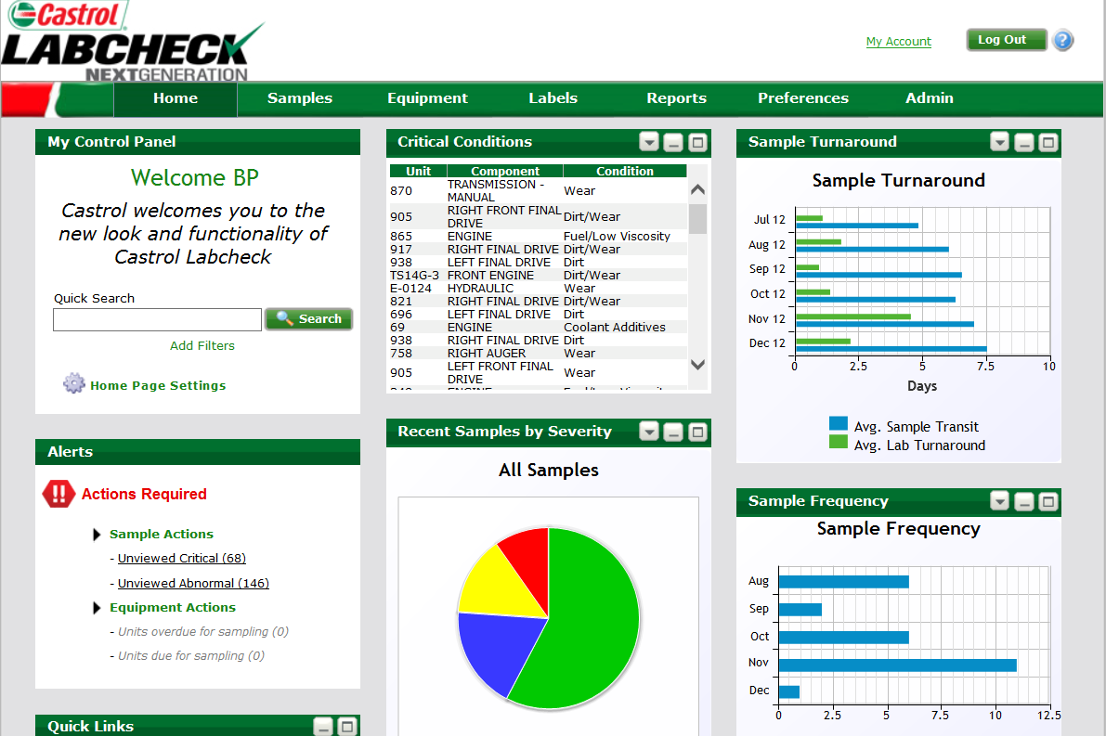
Using Tabs to Navigate
Use “Samples” and “Equipment” tabs to locate & view reports
Your current tab is highlighted
Note: Do not use your web browser's “back” button to navigate. Doing so will take you out of the Labcheck website.

Slide 4
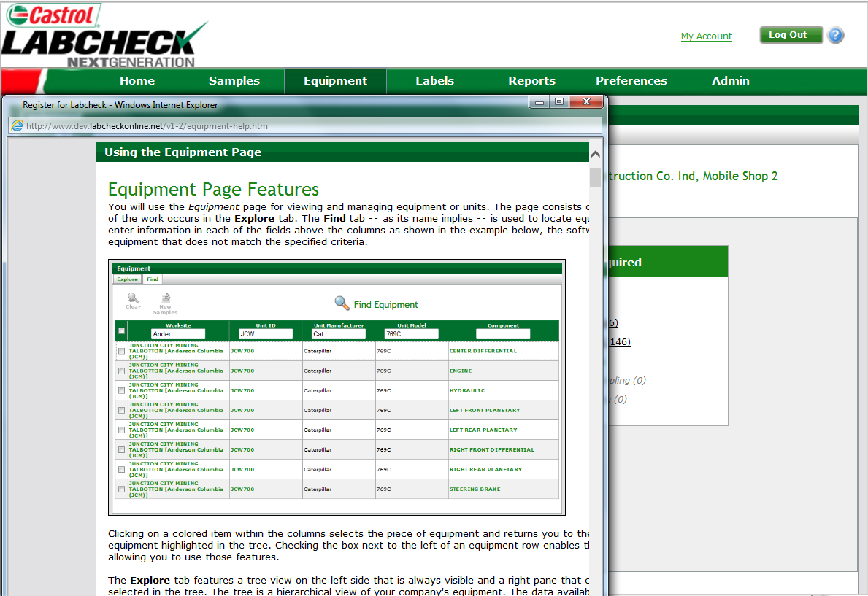
Help Button
Click the “Help” Button to open a window explaining the tab you are currently viewing

Slide 5
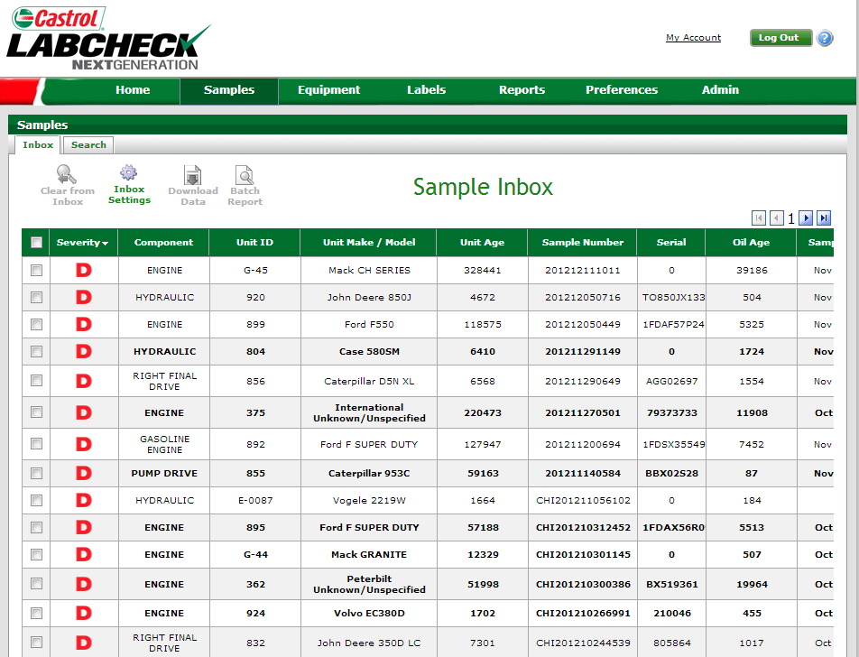
Viewing Reports: Samples Tab
New Samples will appear in your “Inbox” Click anywhere on the sample to view the report
Note: For more detailed instructions refer to the Simple Sample Search & Advanced Sample Search Quick Start Guides

Slide 6
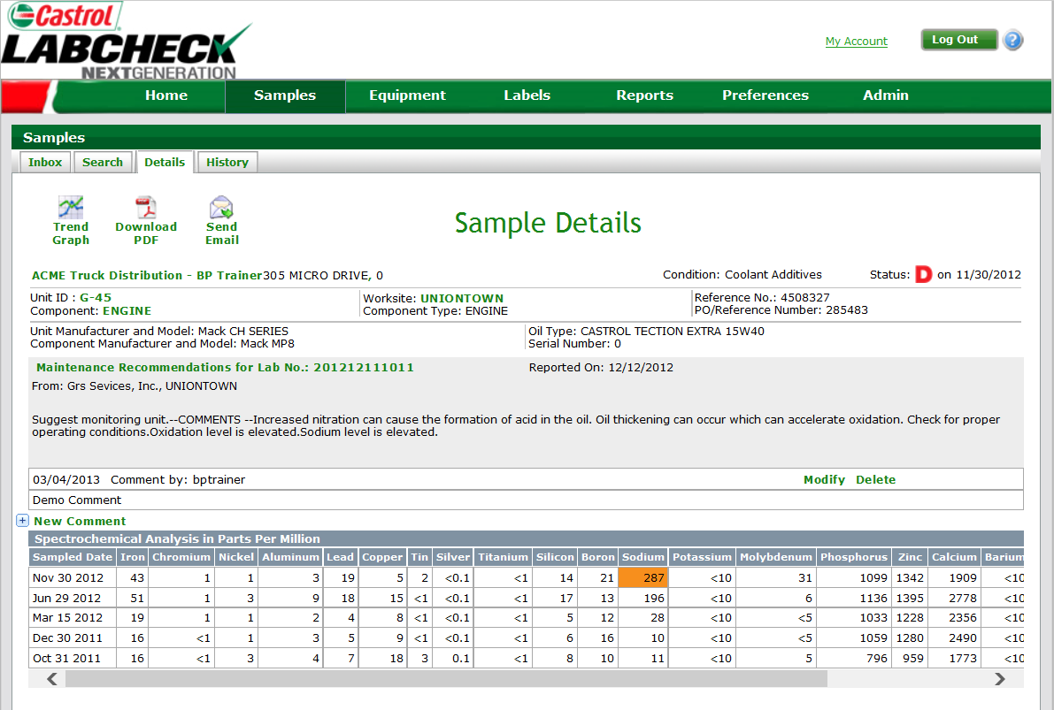
Using Links to Navigate (Samples to Equipment)
Click the links for Unit ID, Component or Worksite, to go directly to that information on the Equipment Tab

Slide 7
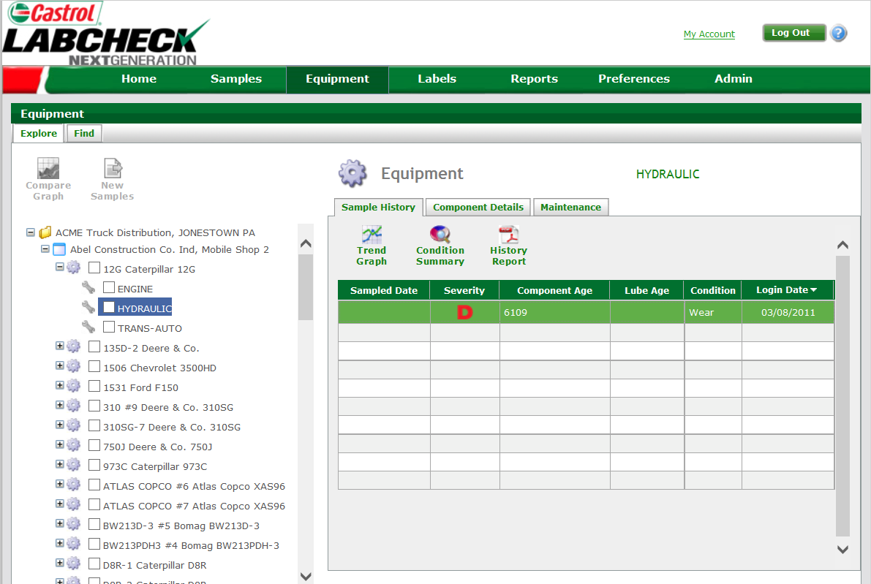
Viewing Reports: The Equipment Tab
Highlighting the component opens your Sample History on the right. Under “Sample History” click anywhere on sample to open the report
Note: For more detailed instructions refer to the Equipment Management Quick Start Guide

