Slide 1
Labcheck Next Generation Quick Start Guide
System Log-in

Slide 2
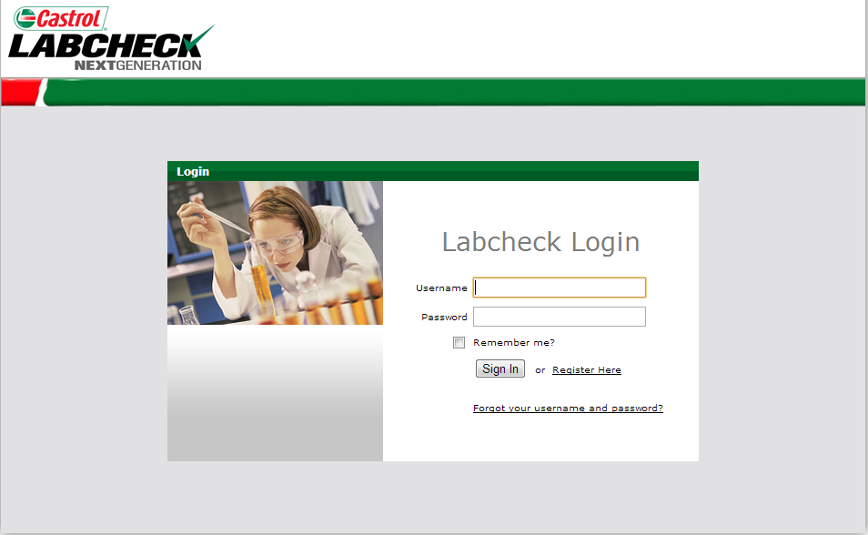
Log-in Screen
New Users: Register yourself below by clicking the “Register Here” link. You can also register by contacting the site administrator or the Labcheck Support Desk
Username/Password
are case sensitive
Use “Remember Me” to
save your password

Slide 3
Log-in Screen
Click
“Forgot Username/Password”
to have a new password sent to your e-mail

Slide 4
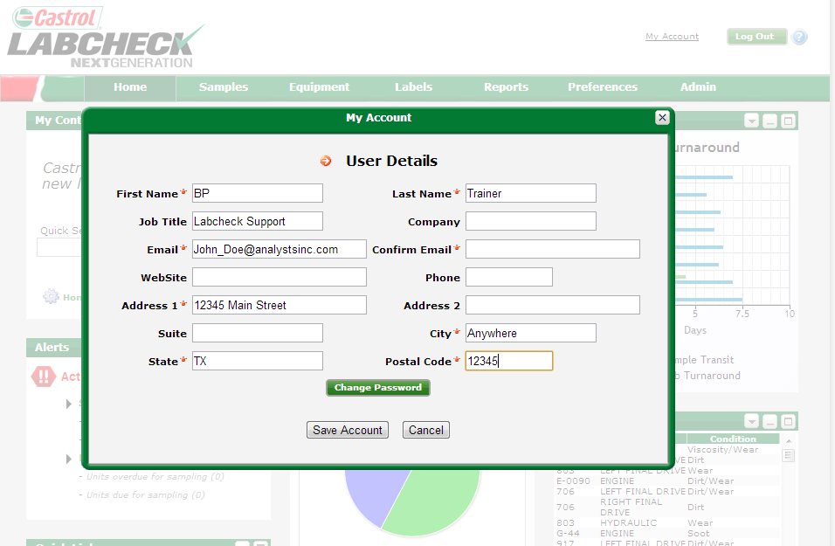
Change Password
“My Account” allows you to update your contact information and change your password.
Your contact information appears on all reports you download, as well as reports that you e-mail from the system
“Change Password” updates your password. We suggest
a password that is simple and easy to remember

