Slide 1
Labcheck Next Generation Quick Start Guide
System Configuration

Slide 2
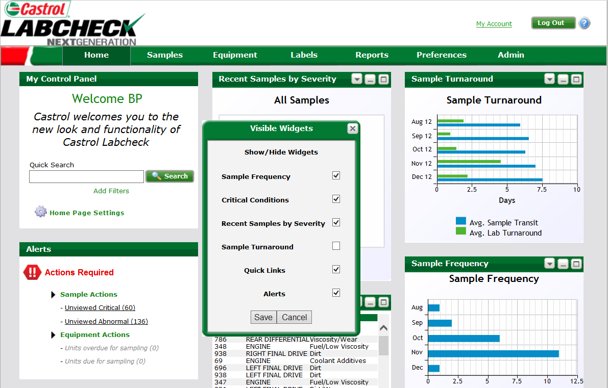
Homepage Display
Step 1:
To configure widgets click “Home Page Settings”
Step 2:
Select the widgets using the check boxes then click “Save”

Slide 3
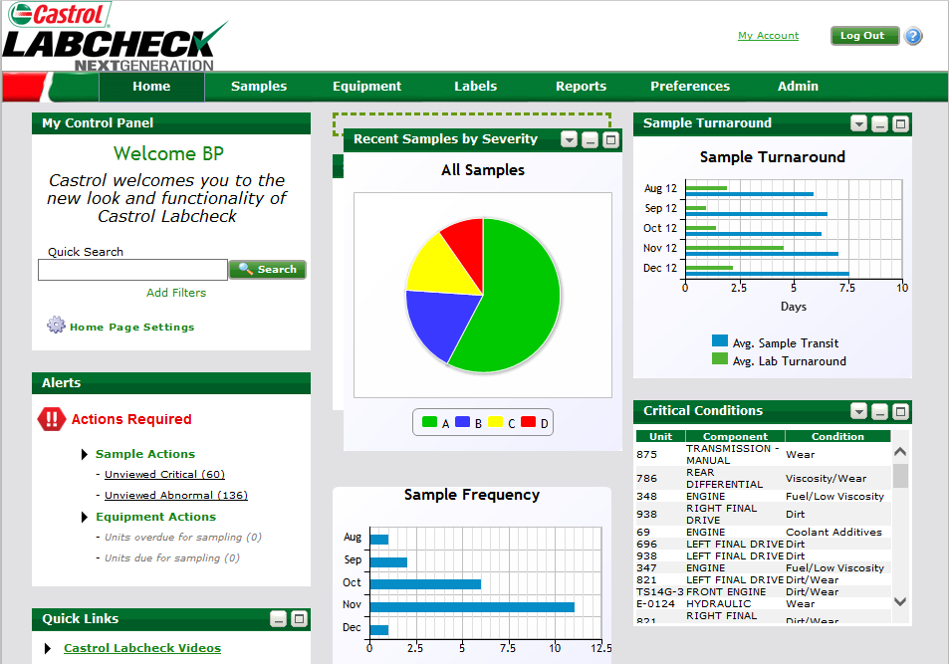
Arranging Widgets
Click the “Settings” icon to select data to be displayed.
To move a widget, drag and drop to the preferred location

Slide 4
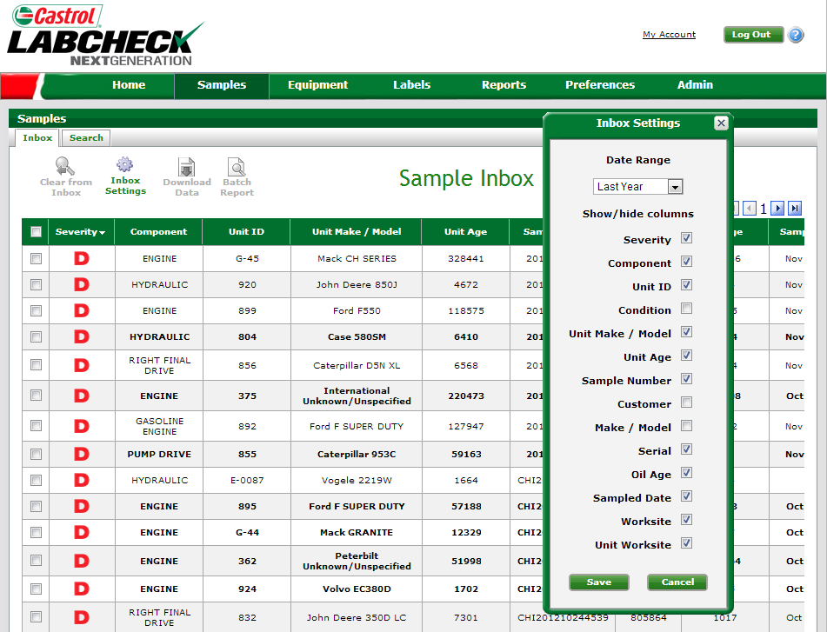
Samples Tab: Configuring the Inbox
Step 2:
Select how long samples remain in the inbox before they are cleared
Step 1:
Select “Inbox Settings” to customize the inbox column headers and date range
Step 3:
Choose the column headers to display. Click “Save” to store your preferences

Slide 5
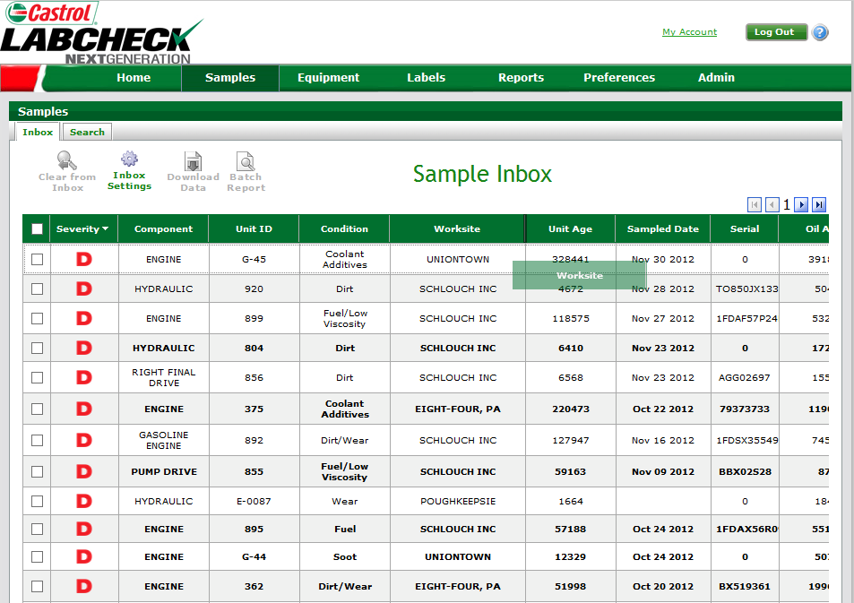
Ordering and Sorting Data
To sort data, click the column header. Triangle pointing down indicates descending order, pointing up indicates ascending order
To reorder columns, drag and drop into the new position. The system automatically saves these changes

Slide 6
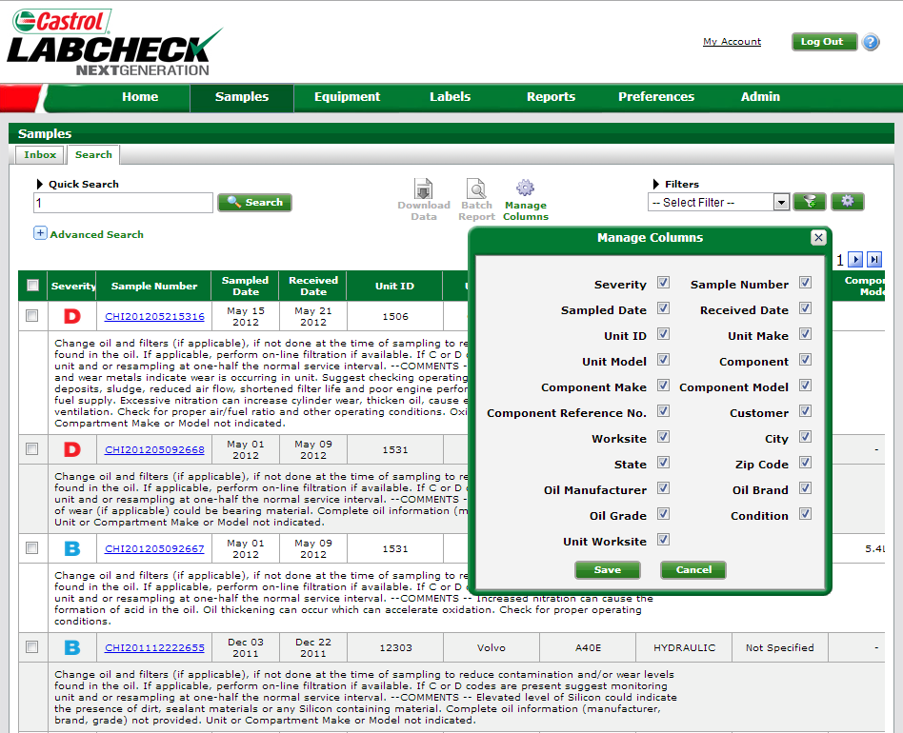
Configuring the Search Display
Step 2:
Select “Manage Columns”
Step 1:
From the Samples
tab click “Search”
Step 3:
Select fields to be displayed and click “Save”

Slide 7
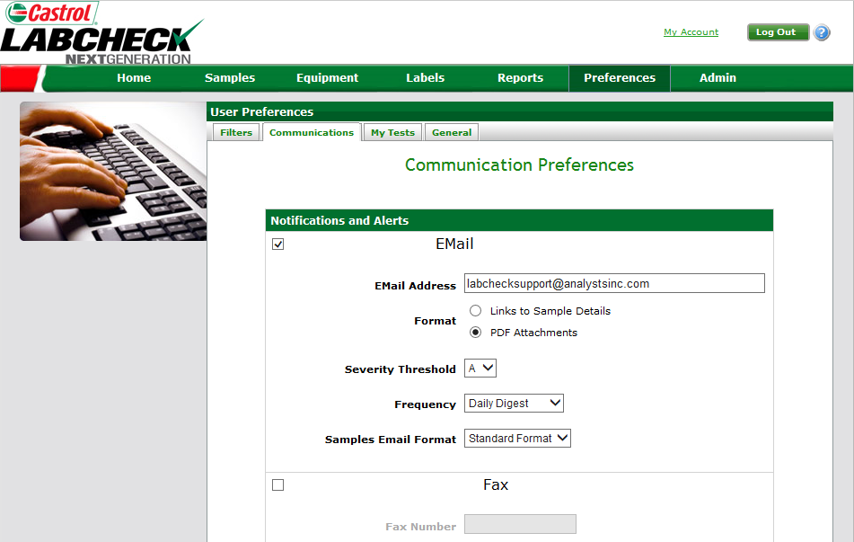
Communication Preferences
Select “Links to Sample Details” to have Links sent to your e-mail. Select “PDF Attachments” to receive PDFs reports to your e-mail
Under Severity Threshold select “A” to receive notifications on all samples

Slide 8
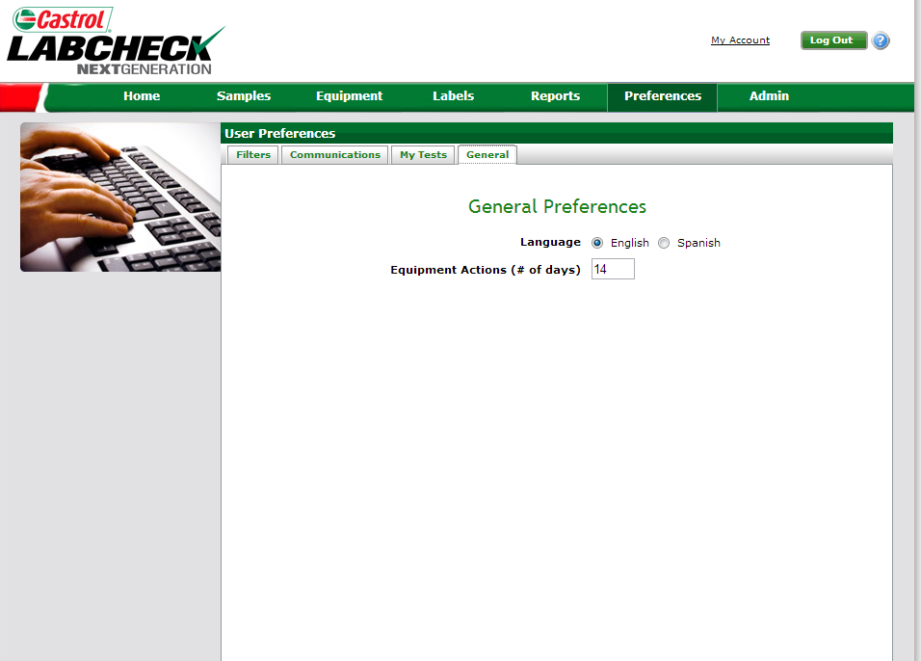
General Preferences
You can choose to have the website display in English or Spanish
Schedule alerts when units are due for sampling

