Slide 1
Labcheck Next Generation Quick Start Guide
Advanced Sample Searching

Slide 2
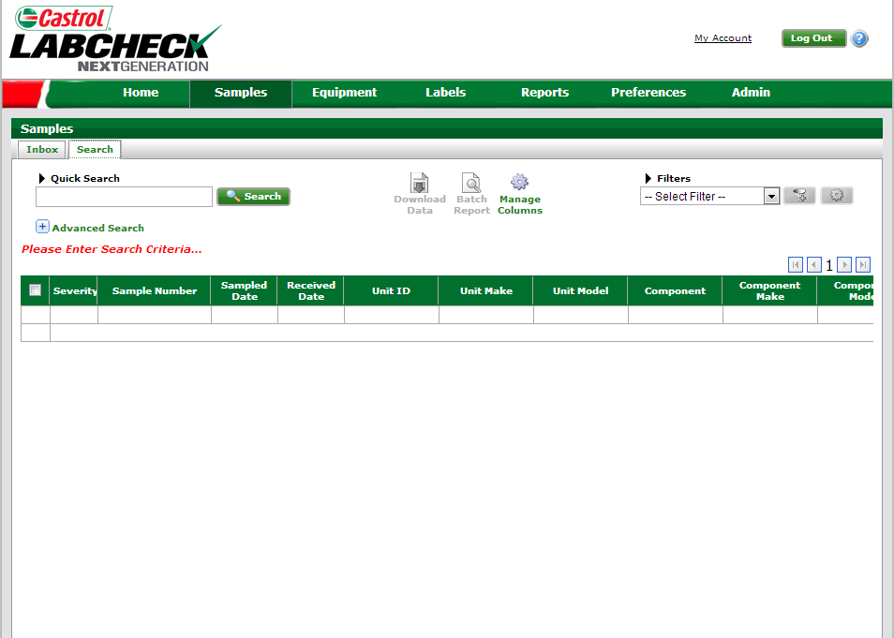
Advanced Searching
In addition to the “Inbox” and “Search” functions, Advanced Search is available
The “Advanced Search” function should be used for searches that contain multiple conditions, such as component type and oil type, etc.

Slide 3
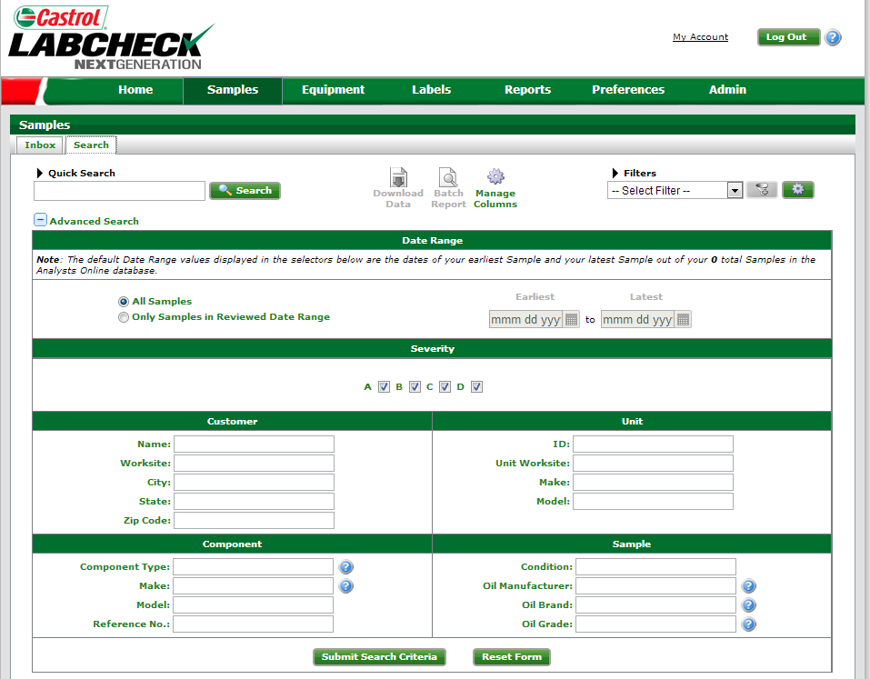
Setting Search Criteria
Search “All Samples” or within a defined date range
Filter by sample “Severity”

Slide 4
Setting Search Criteria (Cont.)
Add additional filters by “Customer,” “Component,” “Unit,” or “Sample” information
Help icons “?” give you an example of search criteria

Slide 5
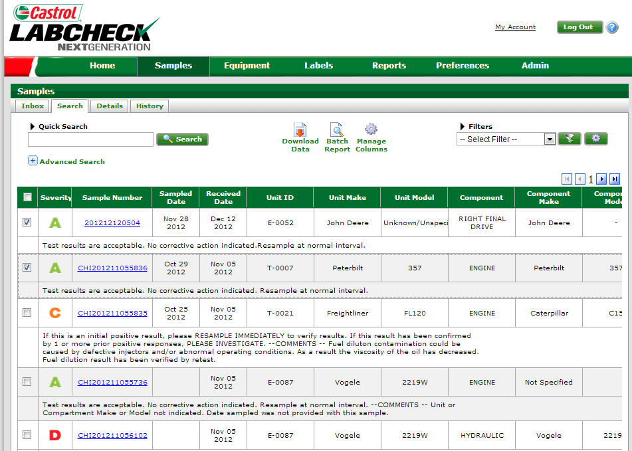
Search Results
Quickly review search results – click on “Sample Number” to view report

Slide 6
Downloading search results
Step 1: Select one or multiple samples to export
Step 2:
Click “Download Data” to export into an Excel format or “Batch Report” for PDF file

Slide 7
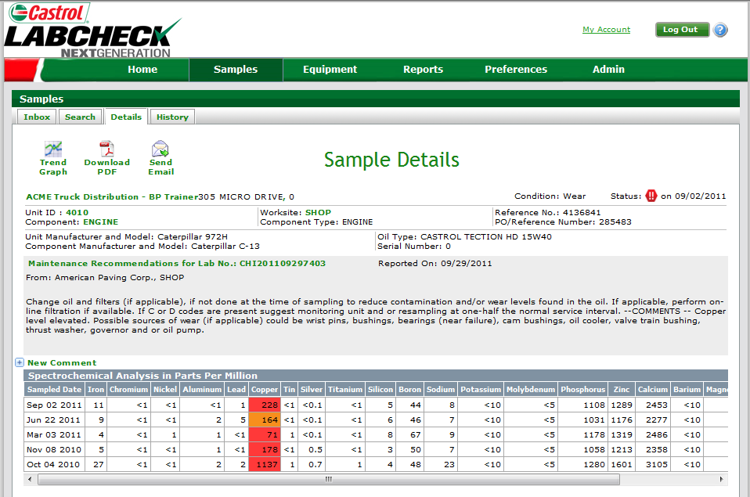
Reviewing Reports
.
Users can pull the report up in PDF format or they can e-mail the report
NOTE:
Oil sample report includes: “Unit ID,” “Component Type,” “Recommendations” and “Results”

