Slide 1
Labcheck Next Generation Quick Start Guide
Simple Sample Searching

Slide 2
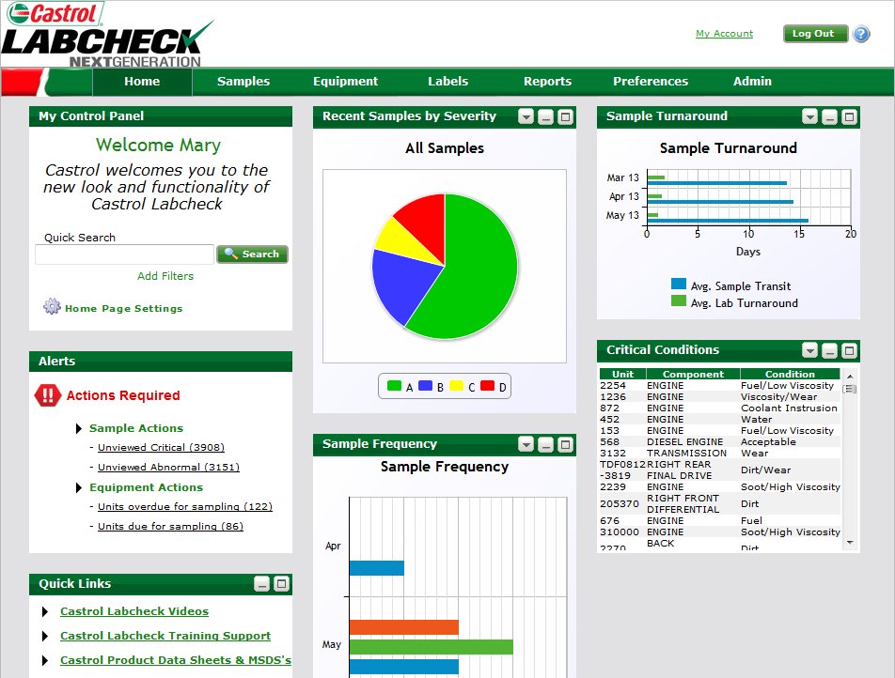
Quick Search from the Home Tab
“Quick Search” allows you to find samples by unit ID, worksite, make/model, or lab number.

Slide 3
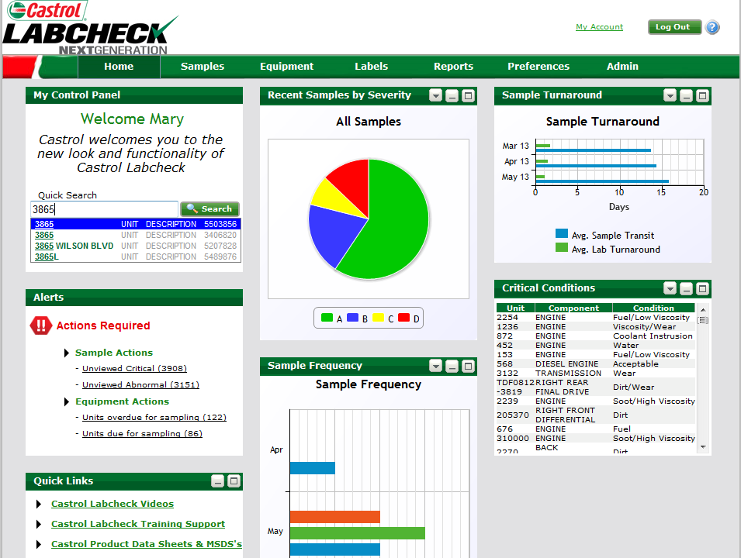
Quick Search from the Home Tab
Less specific searches will pull up more information than specific searches
As you input information, the system will begin to make auto-fill options based on matching criteria, this helps narrow your search to relevant information

Slide 4
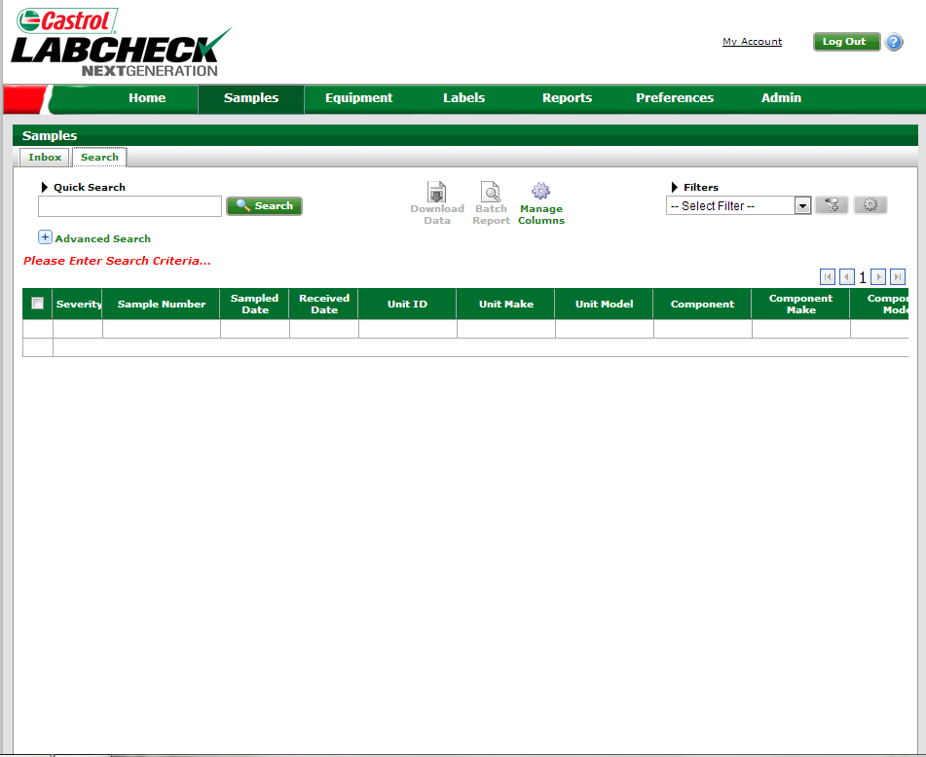
Quick Search from Samples tab
Quick Searches can also be performed from the “Samples” tab by clicking on “Search”

Slide 5
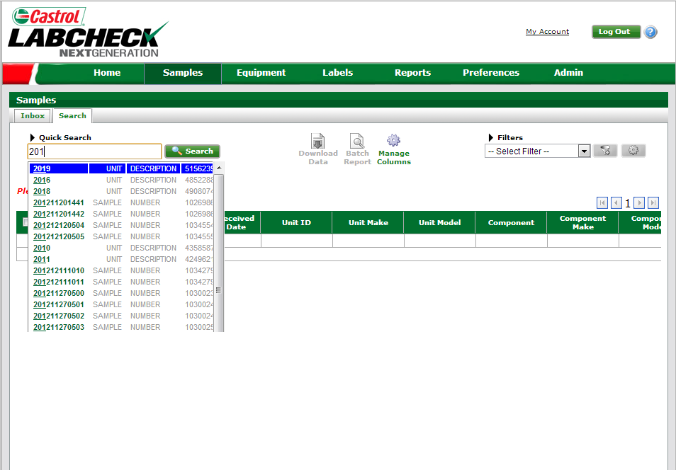
Quick Search from Samples Tab Continued
Less specific searches will pull up more information than specific searches
Selections made through the auto-fill will bring up Sample number, Unit Description, Component type, Customer name

Slide 6
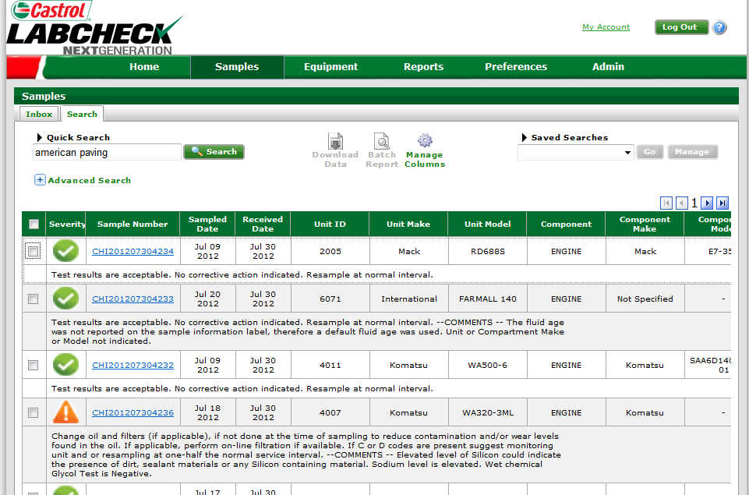
Review Search Results
Configure column headers by selecting “Manage Columns” to display relevant data
Click on individual samples to view Sample Details report

Slide 7
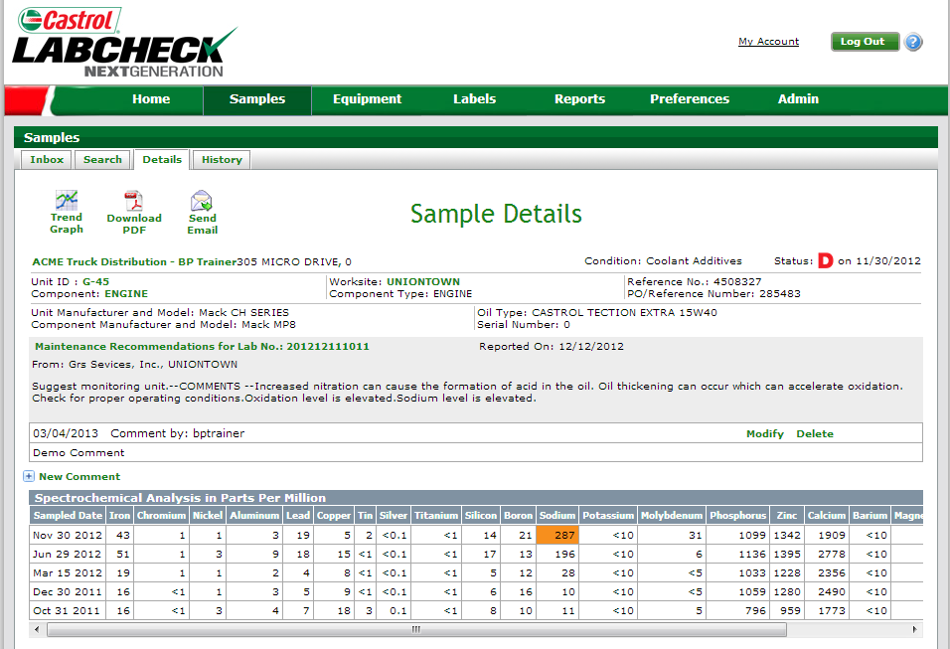
Reviewing Reports
Users can pull the report up in PDF format or they can e-mail the report
NOTE:
Oil sample report includes: “Unit ID,” “Component Type,” “Recommendations” and “Results”

