Slide 1
Labcheck Next Generation Quick Start Guide
Distributions

Slide 2
Management Reports
Depending on your role, Labcheck offers management reports shown in the table below:
Routine Analysis Report
Details sample report of single sample
Submitted Sample History
Details all sample labels submitted
Sample Frequency
Details the sample frequency established for all components
Samples Due
Details all samples due within a given date range
Condition Analysis
Details summary of severities (A,B,C & D codes) over a given time period (up to 12 months), and the details or common issues regarding what caused the abnormal and critical severities
Sample Turnaround
Summarizes sample transit times and lab turnaround times for a given time period (up to 12 months)
Sample Summary
Details the total number of samples run each month for all units and/or components over a given time period (up to 12 months) for a given customer/worksite
Summary of Conditions
Details the severity of each report run for all units/components over a 30-week period
Critical Condition
Details all critical samples over a given time period (up to 12 months)

Slide 3
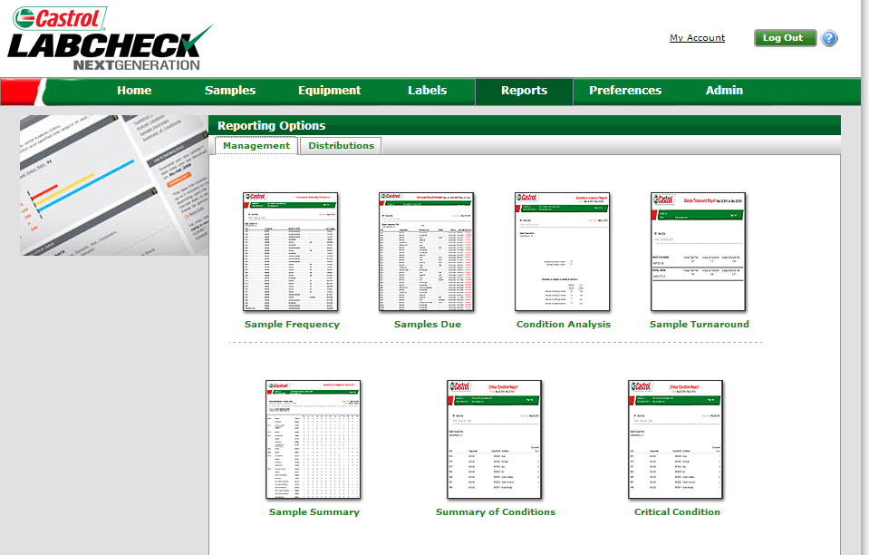
Accessing Distributions
Step 2: Click the “Distributions” tab
Step 1: Click the “Reports” tab
NOTE: This is only available for users with a “role” of manager or higher

Slide 4
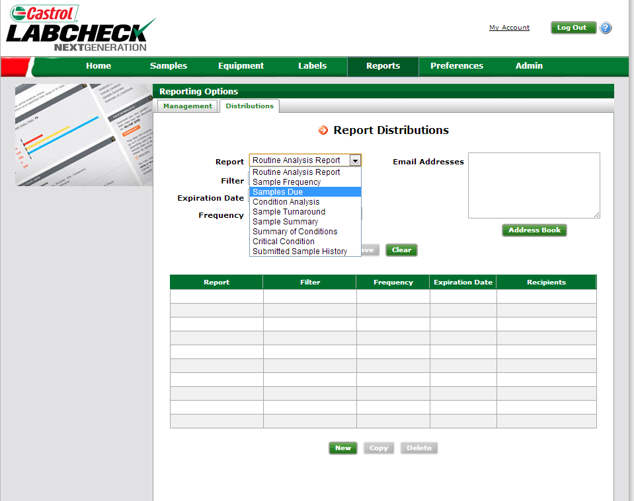
How to set up a report distribution
Step 1: Select which report you would like to send out by clicking on the drop down menu next to Report

Slide 5
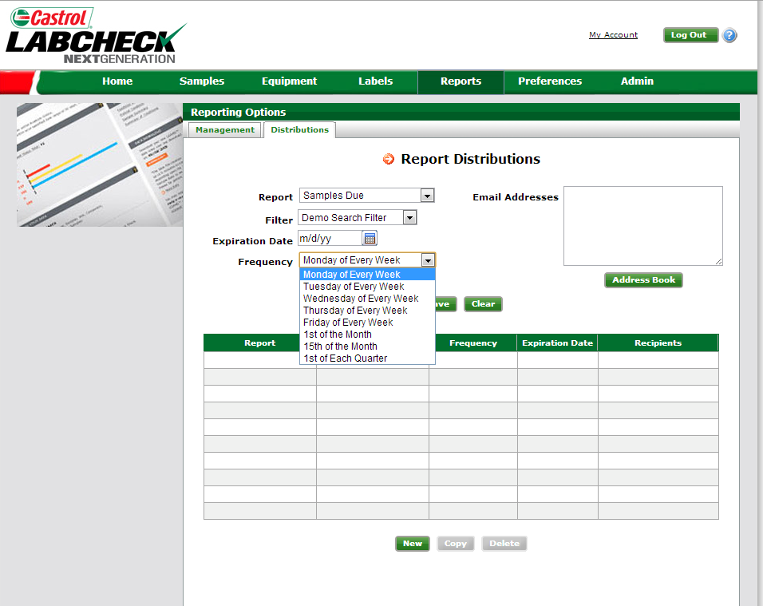
How to set up a report distribution
Step 2: Select your filters, using the drop down box.
NOTE: For detailed instructions, please see Filters Quick Start Guide
Step 3: Select your expiration date if applicable
Step 5: Input the email addresses you would like this report to be emailed to. Separate multiple emails with a comma
Step 4: Select how often you would like these reports to be e-mailed from the drop-down box

Slide 6
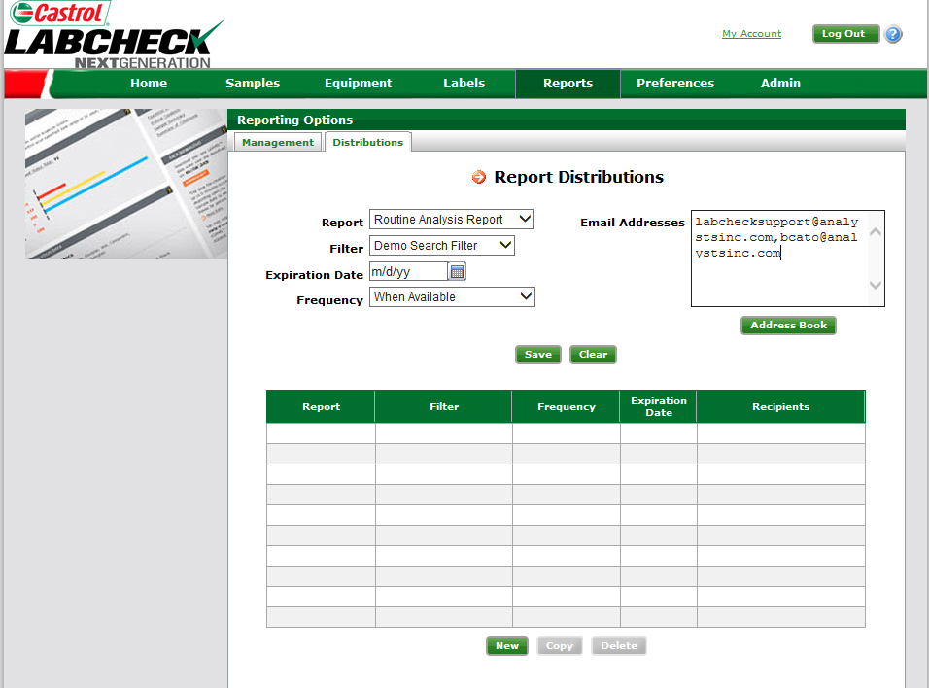
Saving your criteria
Once you have completed which recipients you want to include on the distribution click “Save”. This distribution will now appear in the table below

Slide 7
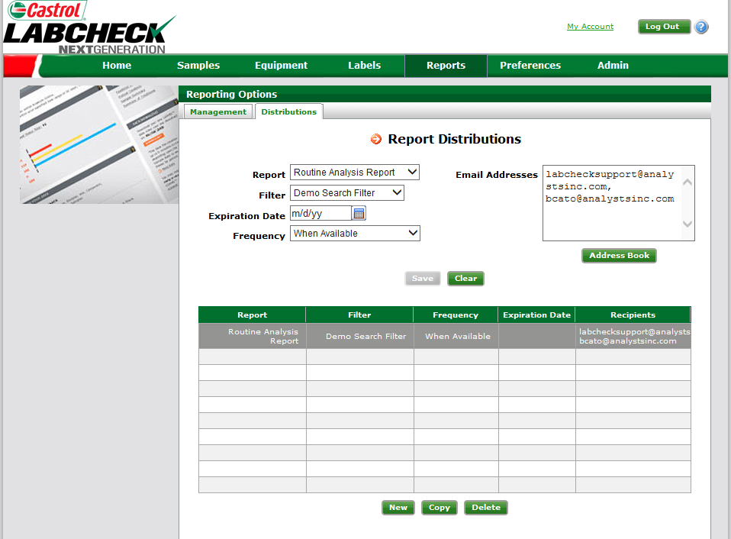
Completed Distributions
Once you have completed a distribution it will appear in the list below. To modify an existing distribution list you must click from the table below, make your changes above or enter additional emails and click save. You can also copy and delete as seen below

