Slide 1
Labcheck Next Generation Quick Start Guide
Advanced Report Distributions

Slide 2
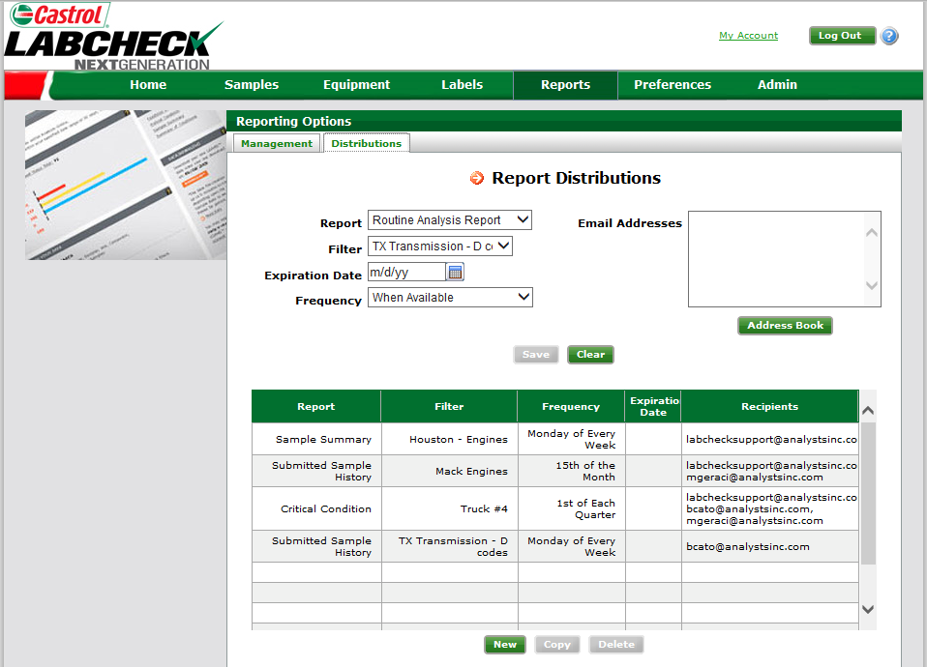
Distribution Lists
This screen shows all of the distribution lists you have set up in the table below

Slide 3
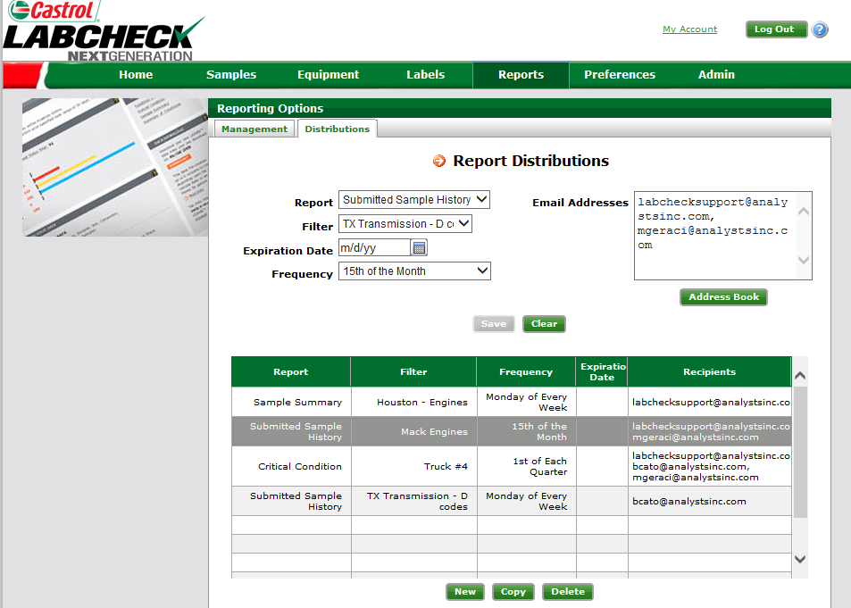
Modifying Distribution lists
To modify an existing list click on a saved lists below. Once selected you can make changes by updating any information above
The “Save” button will not become highlighted until a modification has been made for you to save

Slide 4
Recipients
In the email address table you manually type emails to be added or you can use your “address book” to add/remove people from the recipient list
All email addresses entered above are automatically entered into your address book for future reference

Slide 5
Adding emails to a saved distribution list
Step 1: To add/remove emails from a current saved list first you must select which distribution list to update
Step 2: Click on “Address Book”. This will open up a new window

Slide 6
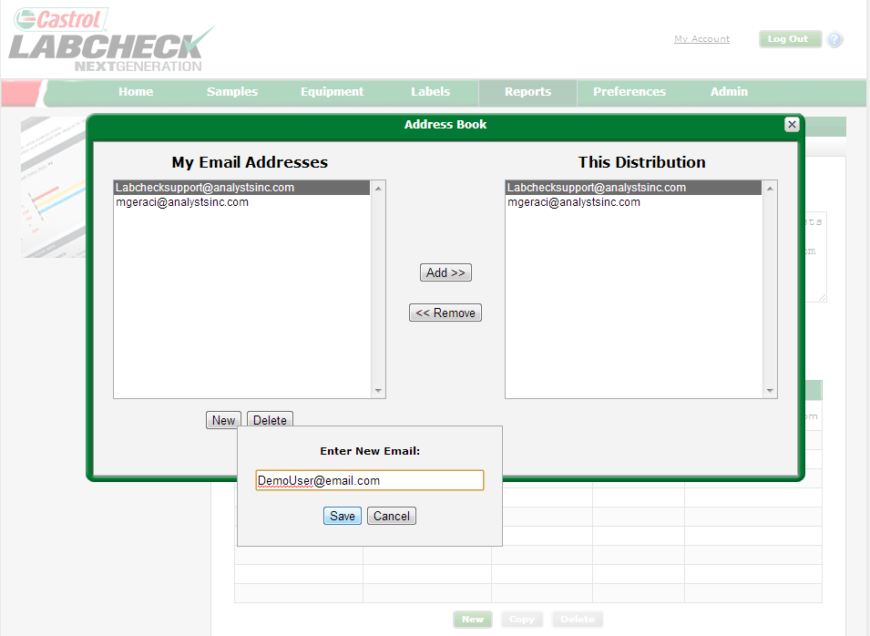
Adding a new contact
To add new users to your address book select “New” and enter the email address and click “Save”

Slide 7
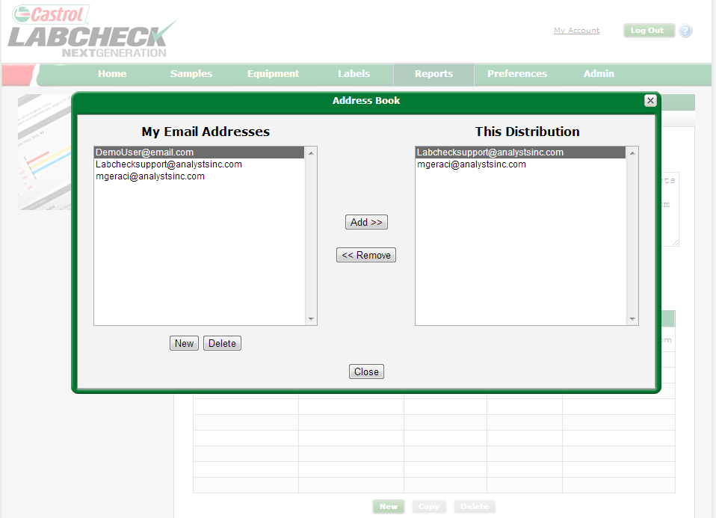
Adding emails to a saved distribution list
“This Distribution” shows contacts set up to receive this report
Under “my email addresses” will show you all contacts you have saved on your profile that are not currently set to receive this report
To update the report distribution you can use the “Add / Remove” buttons. Once completed click “close”
Note: Your changes are not saved until you click “save” on the next screen

Slide 8
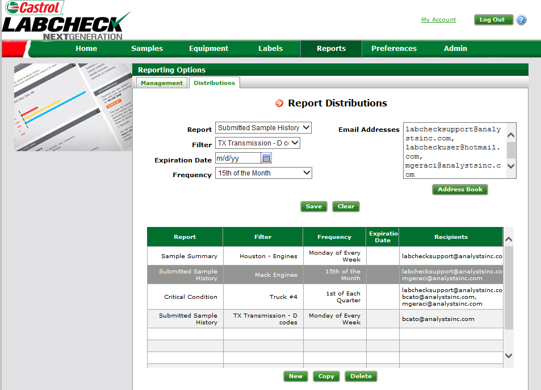
Saving your changes
Once all of your changes have been made you must click “Save” for the changes to take effect

