Slide 1
Labcheck Next Generation Quick Start Guide
Management Reports

Slide 2
Management Reports
Depending on your role, Labcheck offers management reports shown in the table below:
Sample Frequency
Details the sample frequency established for all components
Samples Due
Details all samples due within a given date range
Condition Analysis
Details summary of severities (A,B,C & D codes) over a given time period (up to 12 months), and the details or common issues regarding what caused the abnormal and critical severities
Sample Turnaround
Summarizes sample transit times and lab turnaround times for a given time period (up to 12 months)
Sample Summary
Details the total number of samples run each month for all units/components over a given time period (up to 12 months) for a given customer/worksite
Summary of Conditions
Details the severity of each report run for all units/components over a 30-week period
Critical Condition
Details all critical samples over a given time period (up to 12 months)

Slide 3
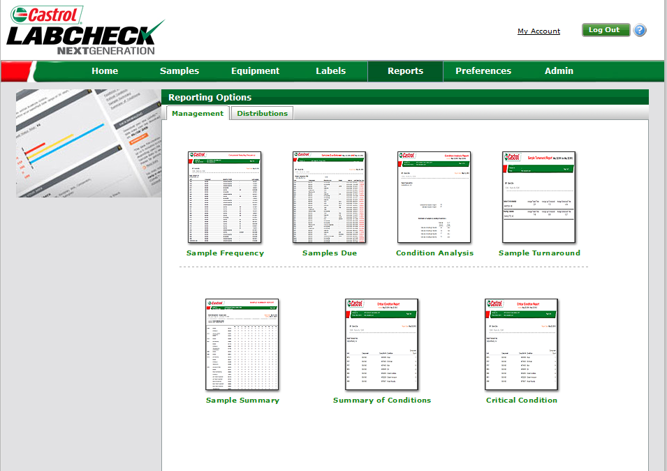
Creating Management Reports
To access your management reports click on the “Reports” tab
Step 1: Click on the report you would like to generate

Slide 4
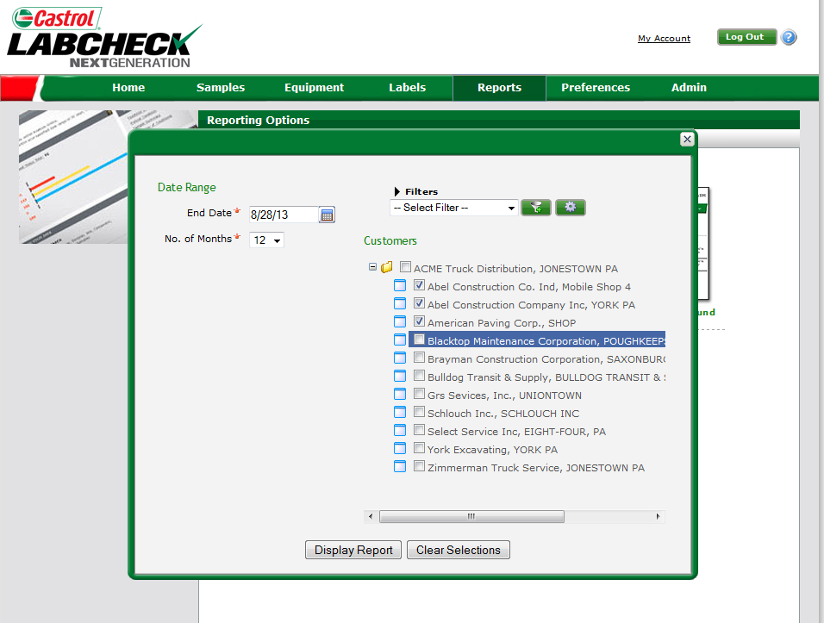
Creating Management Reports
Step 1: Select your date range
Step 2: Select worksite(s)
You can save your selections for future use by clicking on the “Save Filter” button
Note: For more detailed instructions view Filters quick start guide
Step 3: Click “Display Report” to view your management report

Slide 5
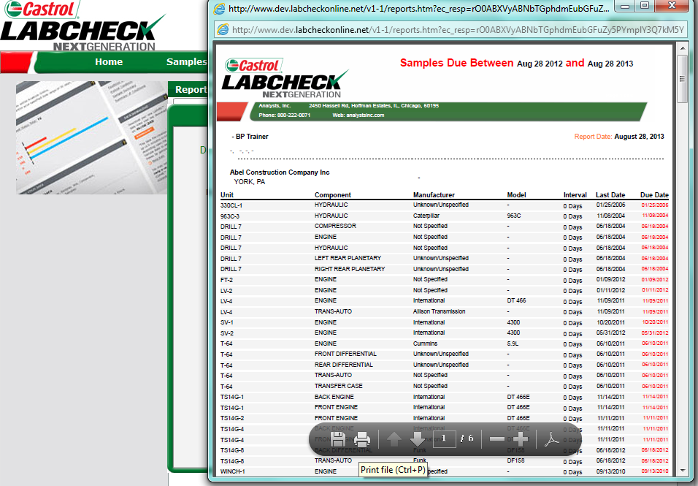
Saving & Printing Management Reports
Note: If the management report does not appear after clicking “Display Report” please ensure that your Pop Up Blocker is set to off.
To print the report: Click “Print” or select (Ctrl + P) on your keyboard
To save the report: click “Save” or select (Ctrl +S) on your keyboard

