Slide 1
Labcheck Next Generation Quick Start Guide
Label Printing – E-Labels

Slide 2
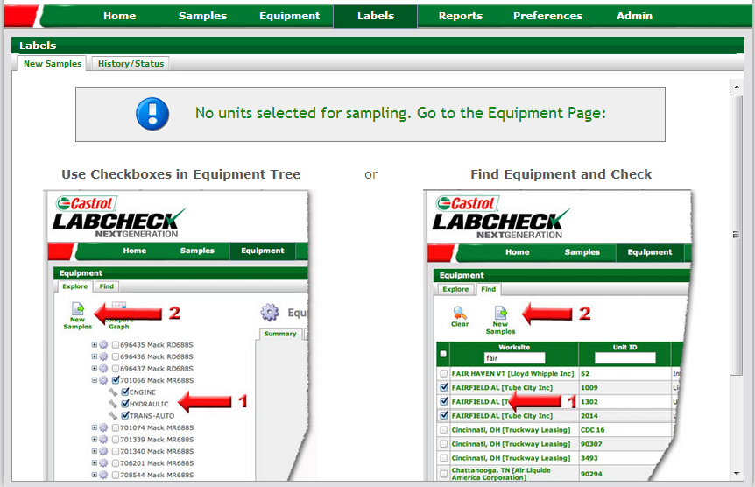
Labels Tab
Step 1: To print sample labels, click on “Labels” tab
Step 2: If no equipment was previously selected, click on “Equipment” tab to select which units/components you want to print labels for

Slide 3
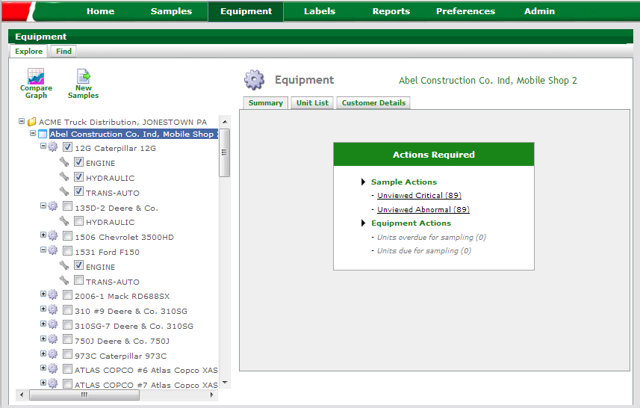
Selecting Labels to Print: Option #1 Equipment Tree
Step 1: To print sample labels, click on “Equipment” tab
Step 2: The “Explore” tab allows you to use the equipment tree for unit / component selection
Step 3: Check the components you want labels for. If you click on the unit, all components will be checked
Step 4: Click the “New Samples” button once completed
NOTE: When printing labels, you can select multiple unit/components across multiple worksites

Slide 4
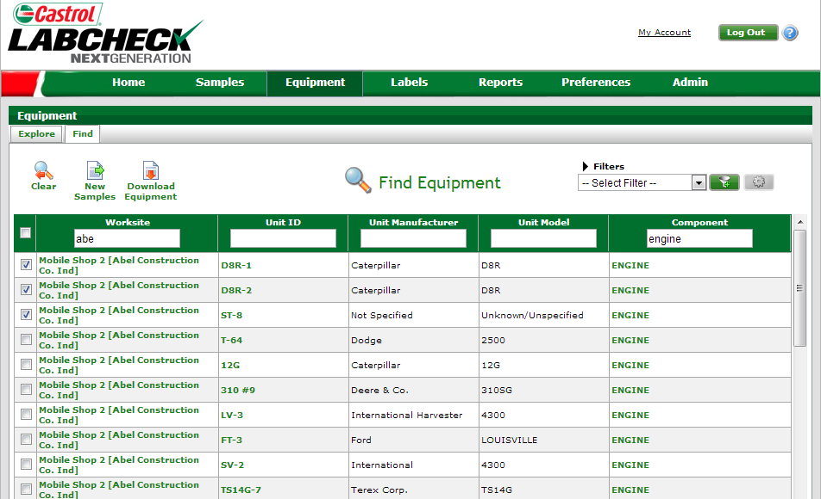
Selecting Labels to Print: Option #2 Equipment Search
Step 1: To print sample labels, click on “Equipment” tab
Step 2: The “Find” tab allows you to use key fields to quickly search for equipment
Step 3: Input key field search criteria and the list of available units and components will populate in the list
Step 4: Check the components you want to print labels for
NOTE: When printing labels, you can select multiple unit/components across multiple worksites
Step 5: Click the “New Samples” button once completed

Slide 5
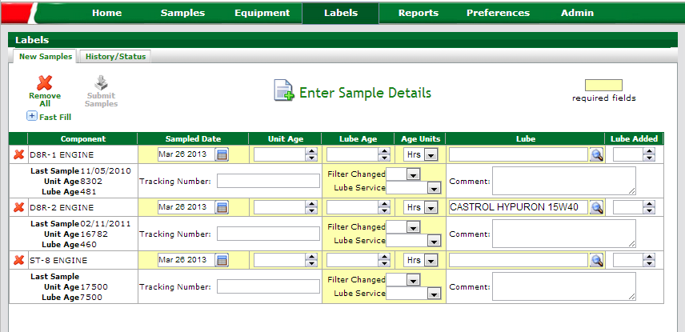
Label Wizard
Previous sample data information provided.
System will pre-populate fields with unit and component data. In cases where no data is on file, fields are left blank.
NOTE: All Highlighted fields must be completed.

Slide 6
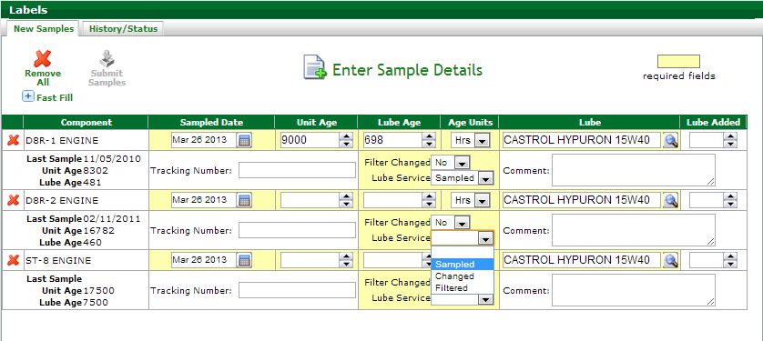
Unit / Lube Age & Service Selection
Input unit age, and the lube age will auto-calculate
Lube age auto calculation is impacted by the lubricant “Service Type” selected on the previous sample
Select service type to be performed

Slide 7
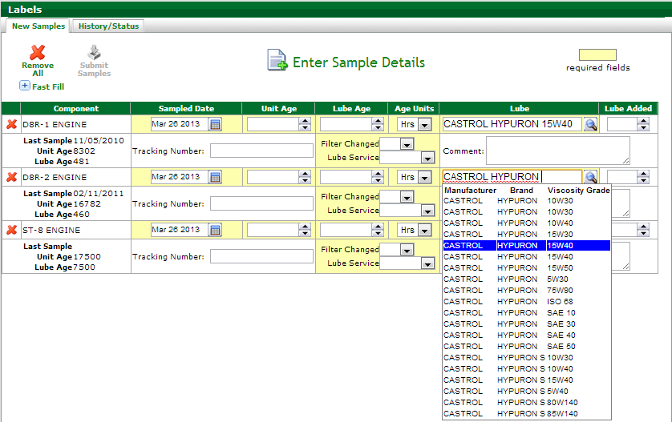
Inputting Oil Type
Update the existing oil type from here, if no oil type is on file, one must be added
Input oil type and Label Wizard will auto populate suggested products as you type. Select the appropriate oil from the list

Slide 8
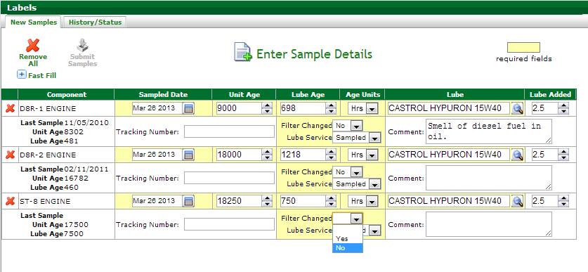
Additional Sample Information
If available, identify how much make-up oil was added to the system. Unit of measure is determine by what is on the component details record
Provide additional information about the sample in the “Comments” box
Select if filter was changed or not at the time the sample was taken

Slide 9
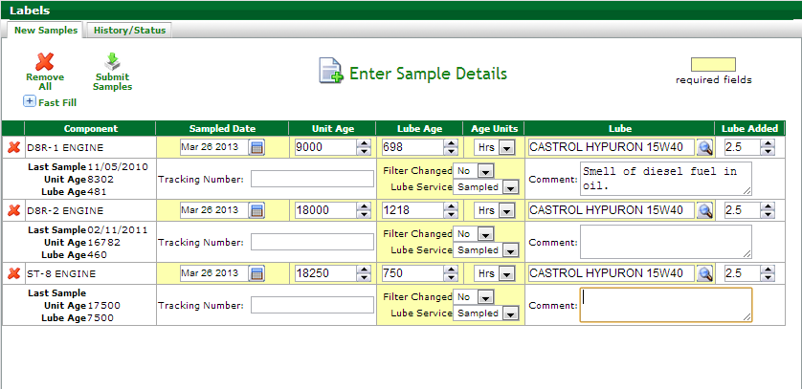
Submit Samples
If printing labels from the Labcheck System, leave the Tracking Number field blank, and e-number will automatically be assigned when you submit samples
Review information inputted and make any changes necessary. Once completed, click “Submit Samples”
NOTE: You cannot submit samples until all required fields are completed.

Slide 10
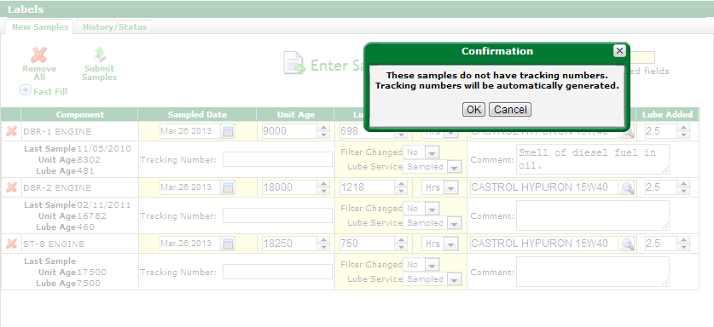
E-Label Confirmation
Confirmation message that an e-number will automatically be assigned to the sample label being generated

Slide 11
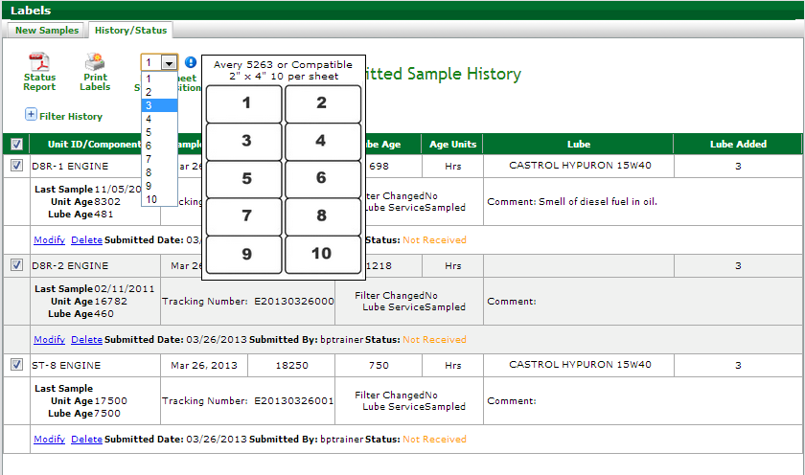
Printing Labels
Once label start position is completed, select the “Print Labels” button
Label reference sheet available by selecting the blue exclamation “!” icon.
Select Label Sheet Start Position.
Labcheck uses a standard Avery label - Sheet #5263

Slide 12
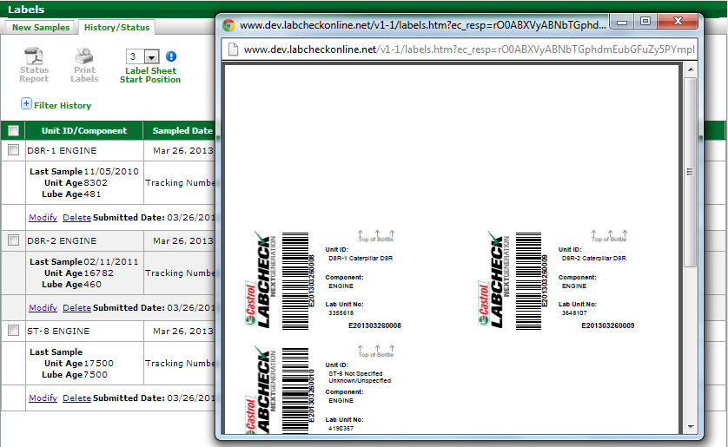
Label Preview
Label Preview will pop-up in a new window. Review labels and make any edits before printing.
Be sure your Pop-Up blocker is disabled, as this may prevent the label preview from opening.

Slide 13
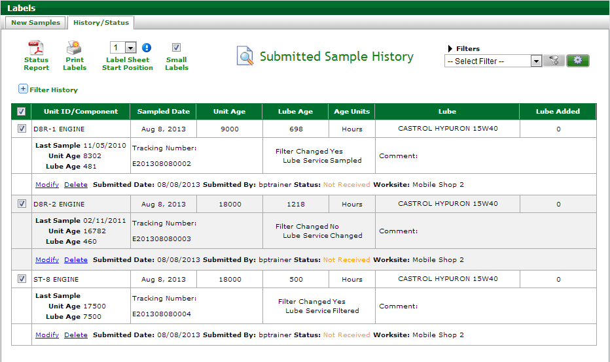
Small Labels
For those who are sending samples in the 2oz bottles the “Small Labels” box will allow you to print using the Avery 5162 labels
Step 1: To print using smaller labels select the “Small Labels” box
Step 2: Click on the “Print Labels” button. This will initiate a new pop up window

Slide 14
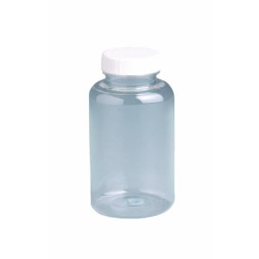
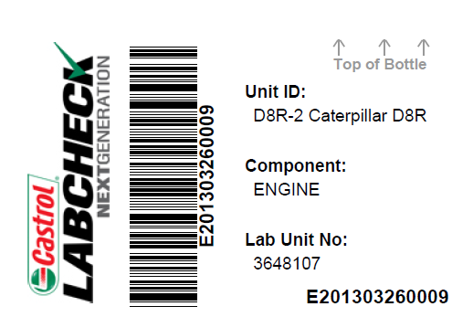
Affix Label to Bottle and Ship to the Lab
Affix label to bottle ensuring the barcode is vertical

