Slide 1
Labcheck Next Generation Quick Start Guide
Equipment Management

Slide 2
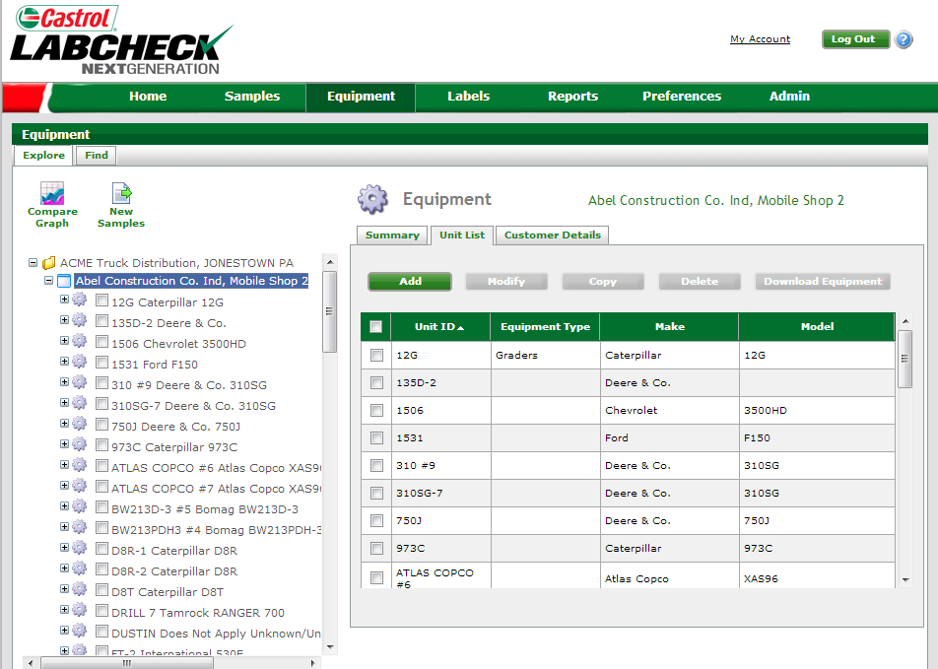
Equipment Tab
Equipment management is performed in the “Equipment” tab
The right side of the page displays relevant information related to items selected within the “Equipment Hierarchy”
On the left side of the page, the “Equipment” displays users worksites, units and components in a tree format

Slide 3
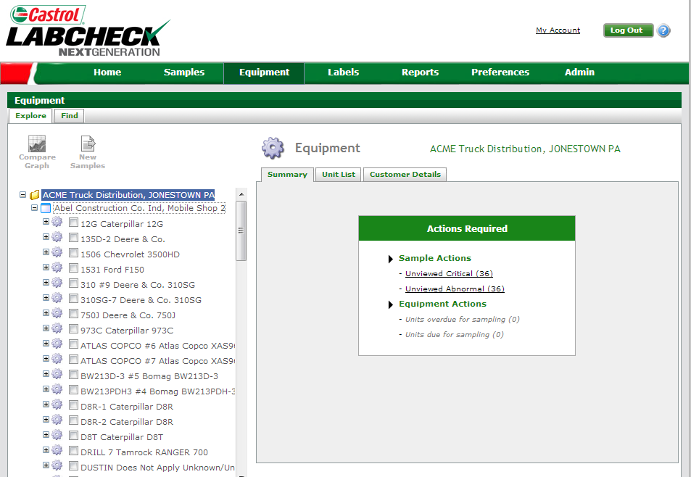
Worksite Level
The tabs within on the right side can be used to display the following:
•Summary Tab – contains a list of unviewed C + D codes and equipment due or overdue for sampling.
•Unit List Tab– contains a list of registered units that can be added to, modified, copied or deleted.
•Customer Details Tab– contains site contact information (address, phone, primary contact).
Worksites are identified by blue “File” icons. When selected, users can view a worksite sample summary, unit list, and site details

Slide 4
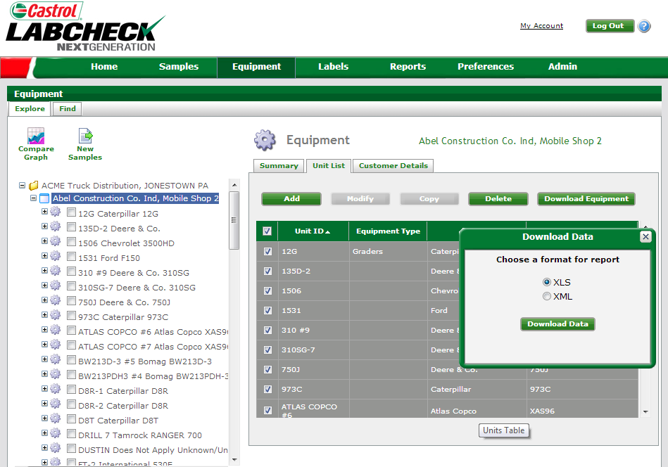
Equipment Lists
Equipment lists can be extracted in both XLS and XML format
Select at the top to extract all or select individual equipment to be downloaded by using the check boxes
XLS – Standard excel format
XML- used for a 3rd party software
Once selected click “Download Data” and a new window will pop up

Slide 5
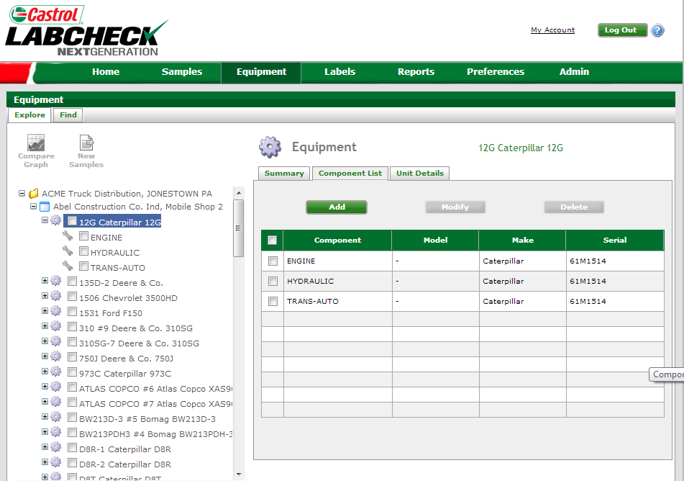
Unit Level
From “Component List”, view registered components associated with a unit and details (make/model, etc.)
Units are identified by “Gear” icons. When selected, users can view a unit sample summary, unit list, and site details

Slide 6
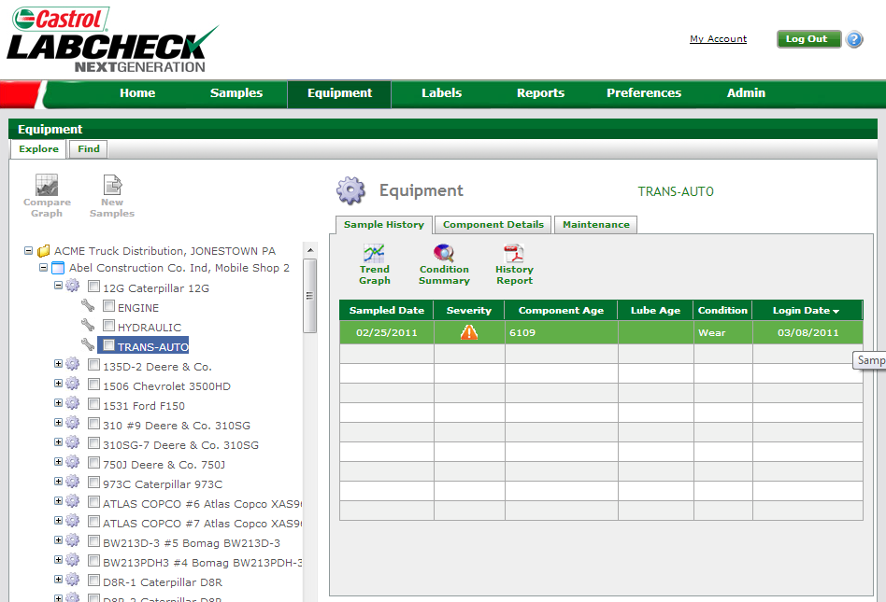
Component Level
From “Sample History”, you can view a list of all samples for this component, component details, and component maintenance events.
Components are identified by “Wrench” icons. When selected, users can view a list of samples, component details, and component maintenance events
Clicking on a sample allows you to go back to Sample Details to review the full report.

Slide 7
Component Level
The “Maintenance” tab, allows you to record significant component maintenance events
From the component, you can also perform a variety of graphing functions

Slide 8
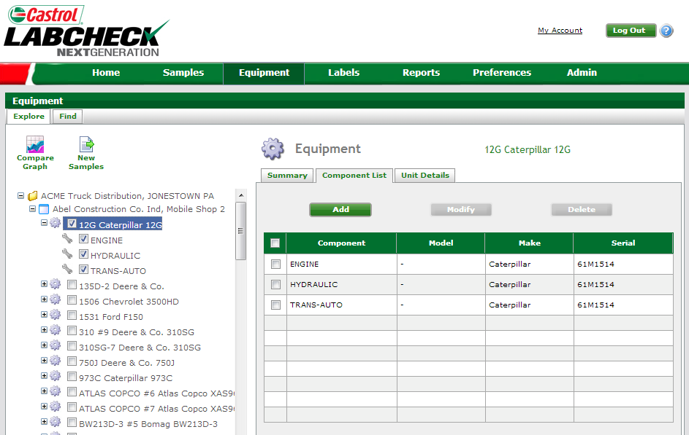
Sample Labels
Sample labels are created from Equipment Hierarchy, “New Samples” tab becomes available by selecting the unit/components you want labels for
NOTE: See Quick Start Guide for more details on generating Sample Labels.

