Slide 1
Labcheck Next Generation Quick Start Guide
Adding New Equipment

Slide 2
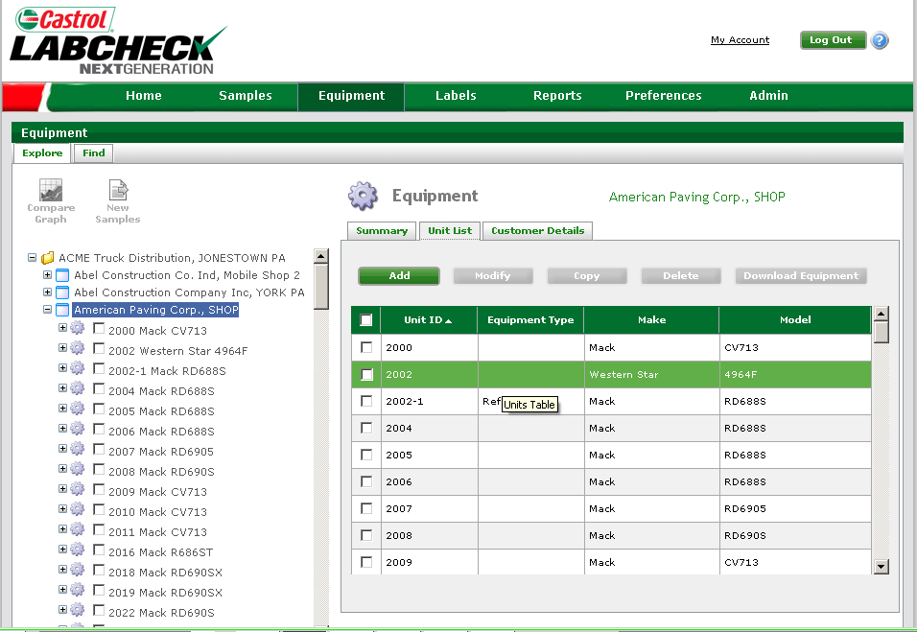
Adding New Units
Step 1:
To add new units click on the “Equipment” tab
Step 2:
Select the worksite you want to
add equipment to, and click on
the “Unit List” tab
Step 3:
Select “Add” to open New Unit Wizard

Slide 3
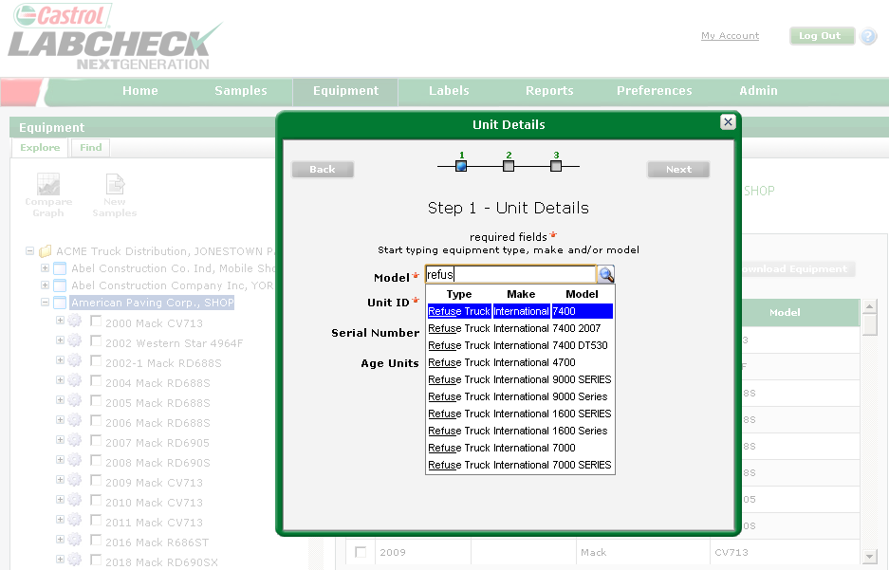
Adding unit Step 1
New Unit Wizard is a three step process that allows users to fully register new units in the Labcheck System
Next to “Model” input equipment by type (dozer, refuse truck, etc.) or OEM make/model. The system will begin to auto populate, allowing you to select the appropriate information

Slide 4
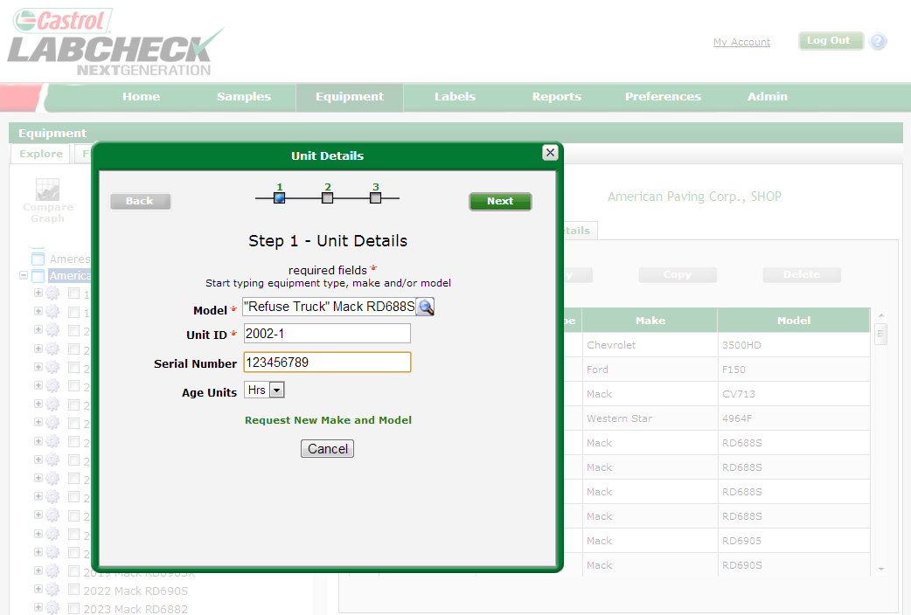
Registering the Unit (Continued)
Input unit “Unit ID” (required), and “serial number” (optional)- Recommended to help assist in preventing or creating duplicate units
If you cannot find the appropriate make/model, you can request that a new one be added to the database

Slide 5
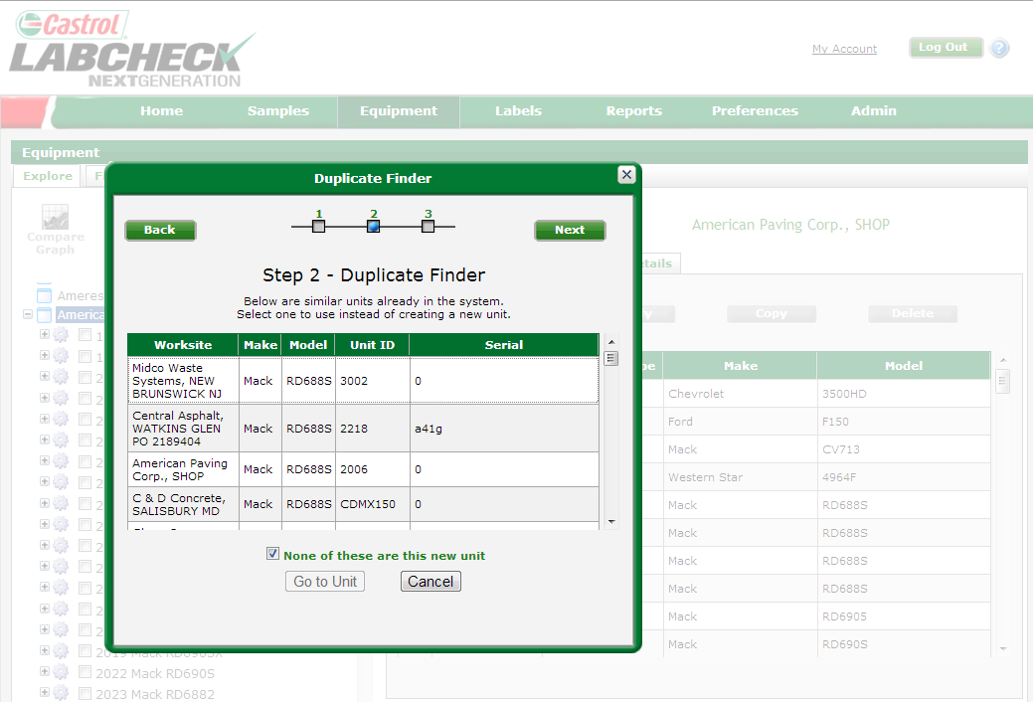
Duplicate Finder
Step two of the New Unit Wizard searches your records for duplicate units. The search covers multiple worksites that you have access to.
The Equipment Wizard will identify possible duplicate equipment based on Unit ID, make/model, and serial number matches
NOTE: System will only identify duplicate units that the user has access to.
If none of the units listed are the new unit being created, you must check the box to continue

Slide 6
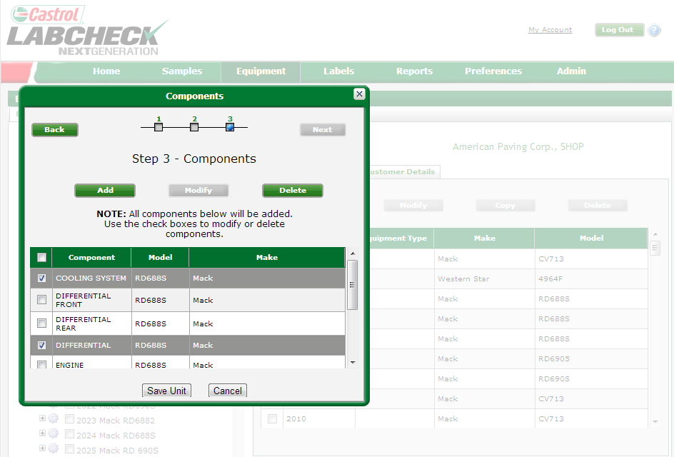
Registering Components
Step Three of the New Unit Wizard allows you to add components to the unit.
If the component you want is not listed, you can add it by clicking the “Add” button
Select from the available components by clicking on a box to Modify or Delete the components you don’t want registered
When completed click on the “Save Unit” button to register the new unit and associated components

Slide 7
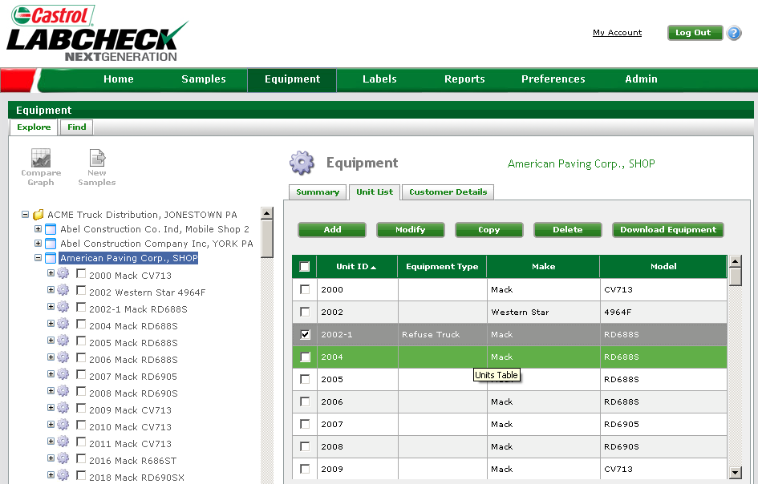
Updating Units
To update or make changes, select the unit and appropriate button to “Modify”, “Copy” or “Delete”
New units created will now be listed in the under the worksite and unit list

Slide 8
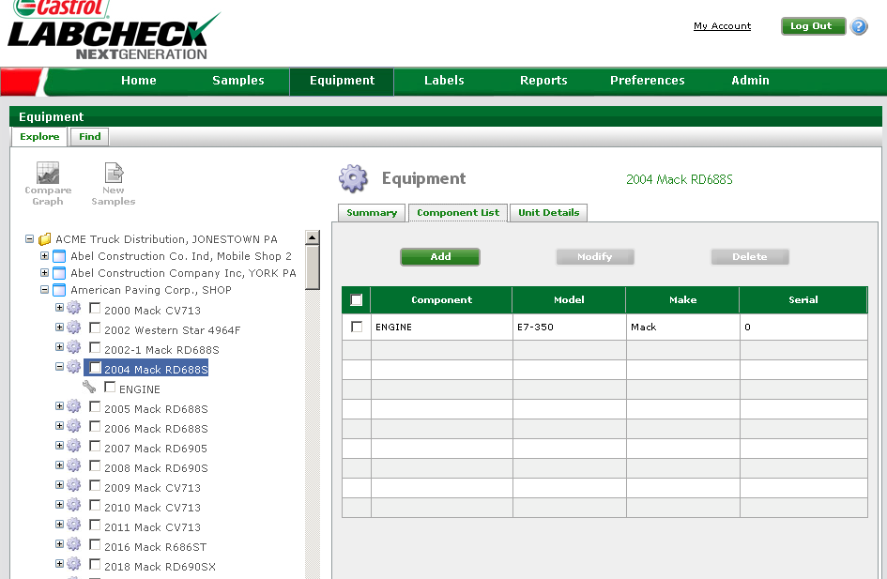
Adding Components
Step 2: Select component list to view all components under the unit
Step 3: To add components click the “Add” button
Step 1: Select the unit that will add a component
To modify or delete a component, first check the box then click “Modify” or “Delete”

Slide 9
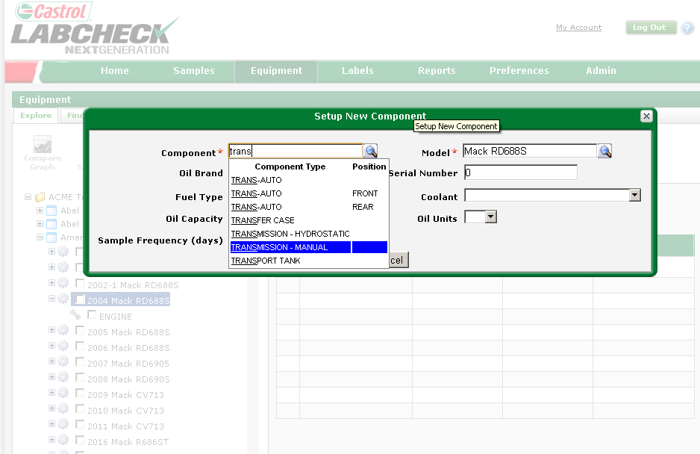
Adding Component details
Type information into the field, system will auto populate helping you identify the correct component
Magnifying glass identifies smart search or “Auto fill” functionality

Slide 10
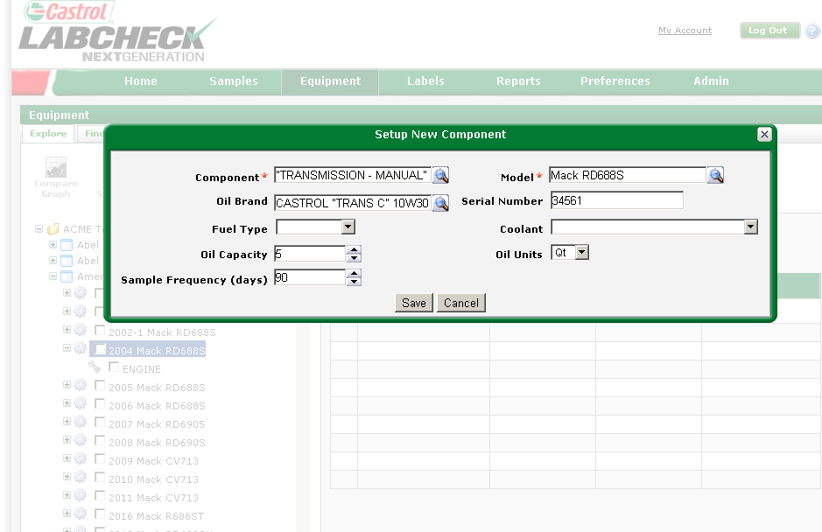
Adding Component information
“Component” and “Model” fields are required. Fill in any additional information
Click “Save” to add the component to the unit

Slide 11
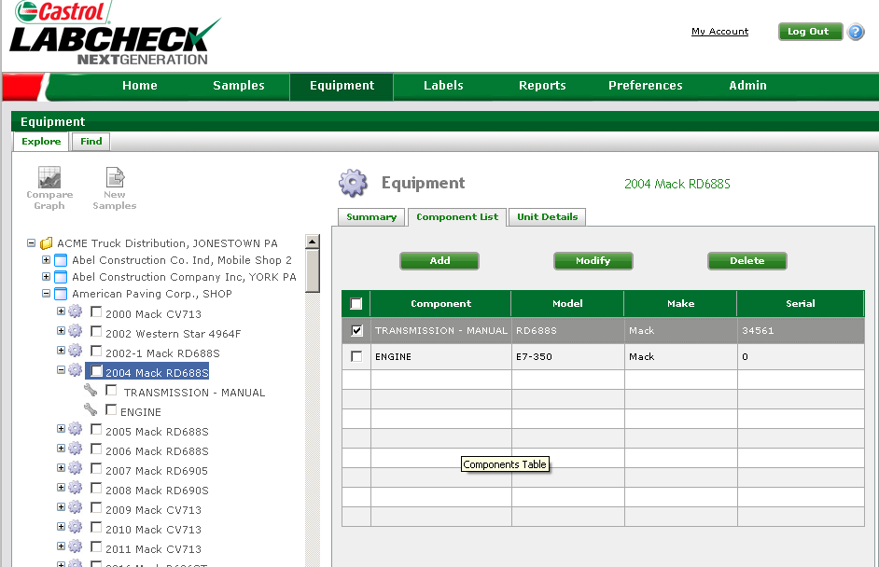
Component View
Once completed, the new component will show up on your component list
To modify or delete a component, first check the box then click “Modify” or “Delete”

