Slide 1
Labcheck Next Generation Quick Start Guide
Admin Basics

Slide 2
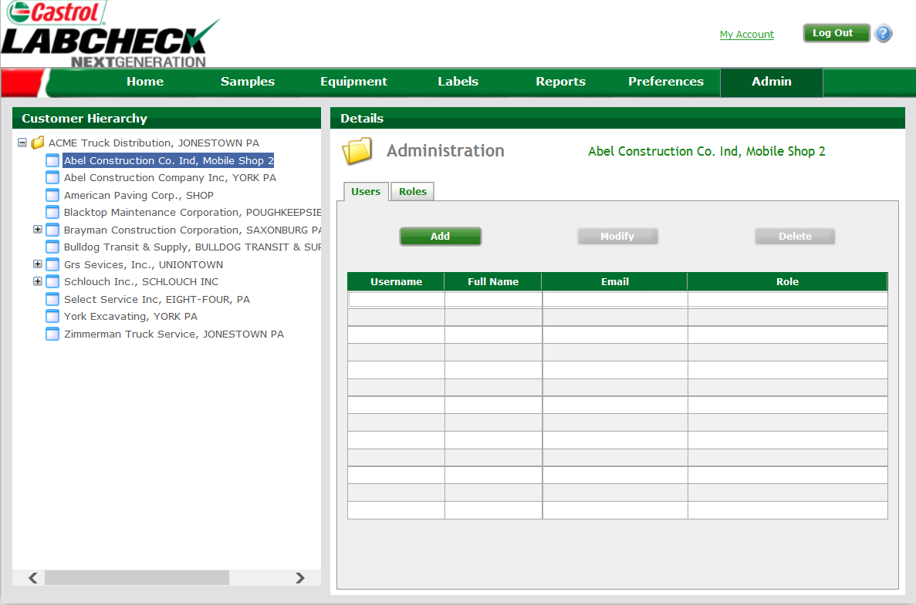
Using the Admin Tab
Use the Admin Tab to: add users, manage users, create roles, and update worksite information.
To add new Users click on the “Admin Tab”
If you do not see the Admin tab when you login in, you do not have admin privileges. Please contact your company admin or Castrol Rep.

Slide 3
Using the Admin Tab
Step 1: Select the worksite
Step 2: Select the “Add” button to create a new user for this worksite. A pop-up window will appear

Slide 4
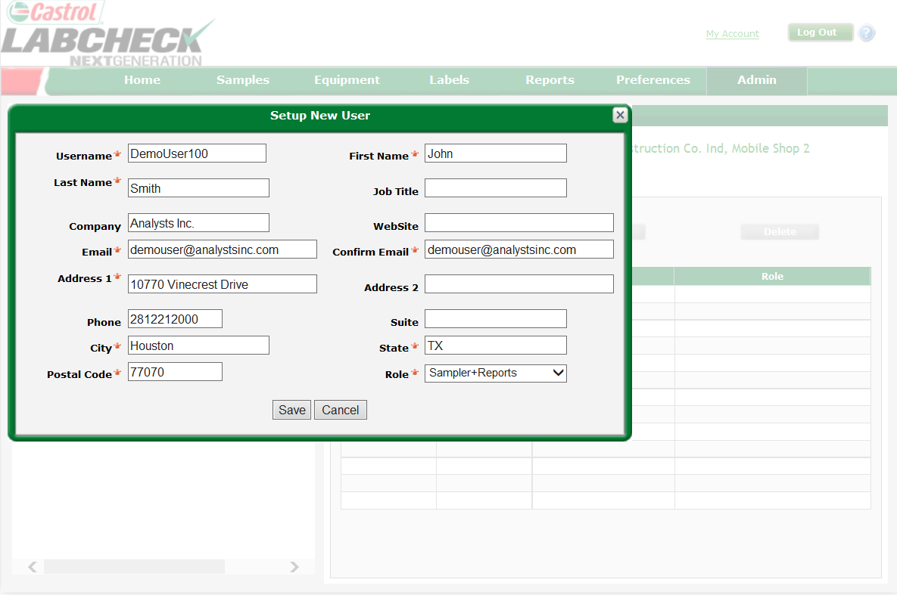
Entering Users Information
Step 1: Complete all of the required fields as marked by a red “*”
Labcheck Online has four Roles:
Administrator: Full access
Manager: Equipment management, add, edit, delete, and move units
Sampler + Reporter:
View all equipment, print labels and access management reports
Sampler: View all equipment & print labels
Step 2: Click “Save” to complete user registration. Once saved
the user receives an email which includes username, password,
and login instructions

Slide 5
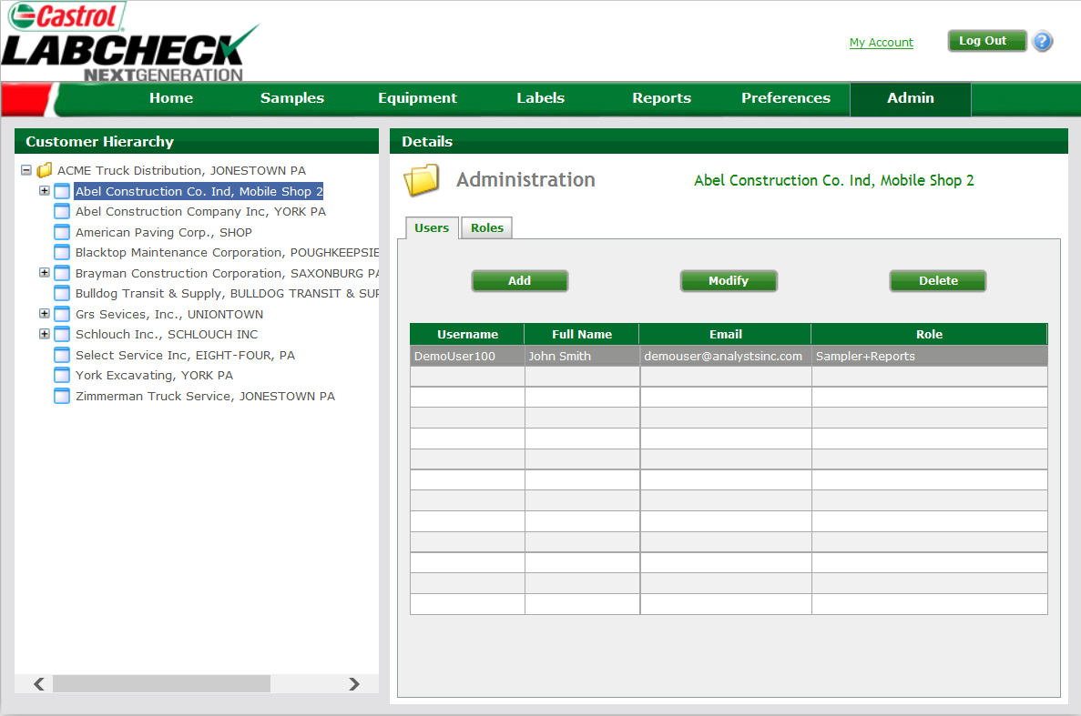
Modifying or Deleting Users
Select the worksite with the user you would like to modify or delete
Choose “Modify” or “Delete”. All contact information can be changed with the exception of Username. To change a username, delete the user and add them again. Usernames can only be used once
Highlight by clicking on the user you would like to modify or delete

Slide 6
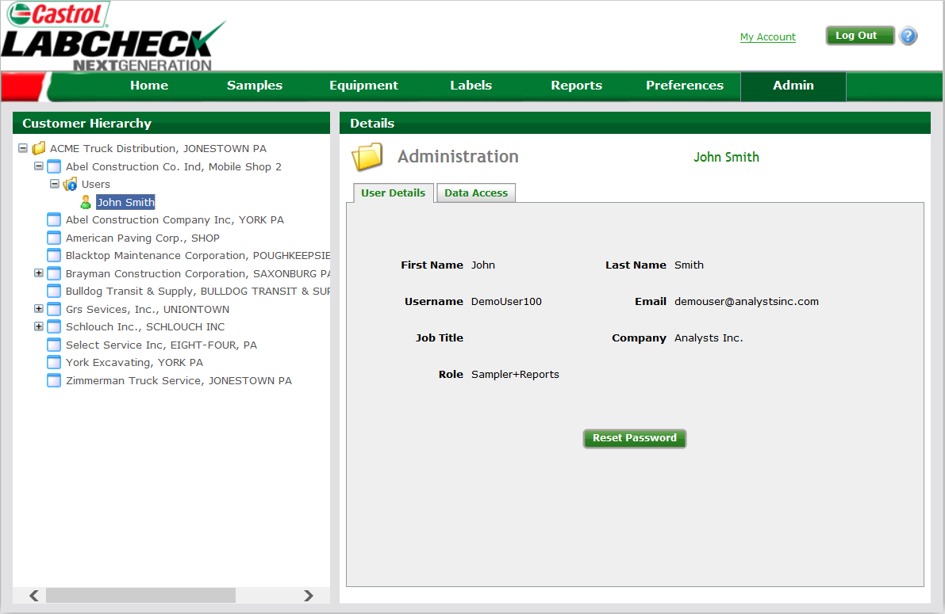
Resetting User Passwords
Data Access shows which worksites a user views and allows you to make changes
Expanding the worksite tree allows you to view the users folder for that worksite. Here you can review user details, reset the user’s password, and further control data access
Clicking on reset password will email the user a new system generated password
NOTE: Only a user can see their password, use Reset Password for any user needing help logging in.

