Slide 1
Labcheck Next Generation Quick Start Guide
Advanced Admin: Managing User Roles/Permissions

Slide 2
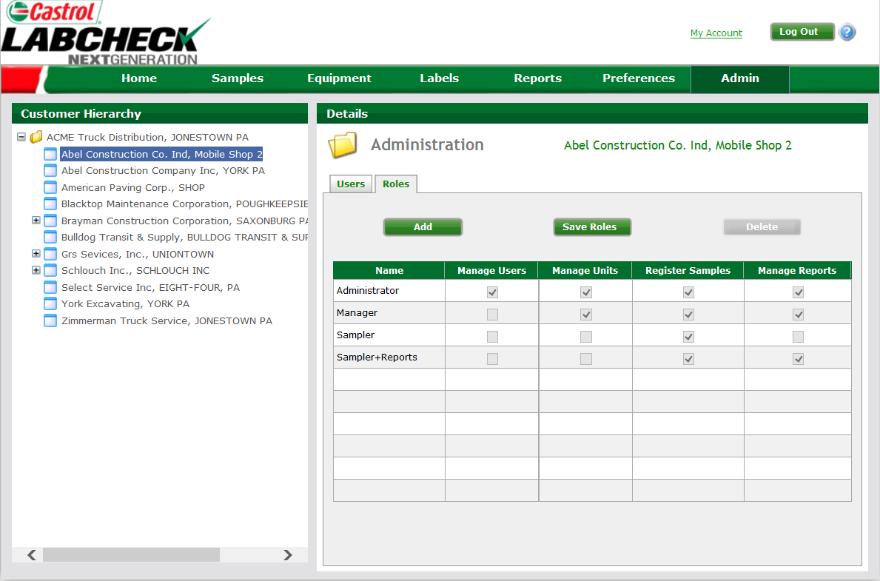
Managing User Roles
User Roles (Permission Levels) determine what features a user can access when logged in
To review the available roles for a worksite, select the worksite you want, and click on the “Roles” tab under “Details”

Slide 3
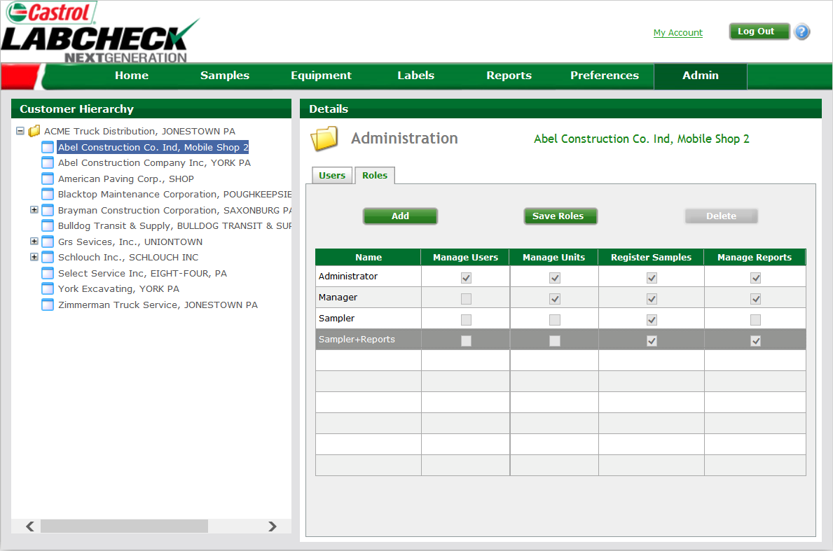
Creating Custom Roles
Four Labcheck Online roles:
Administrator: Full access within the system
Manager: Equipment management features, add, edit, move and delete units
Sampler: View equipment and reports, print labels
Sampler + Reporter: View equipment, print labels and access management reports
Click “Add” to create customized roles

Slide 4
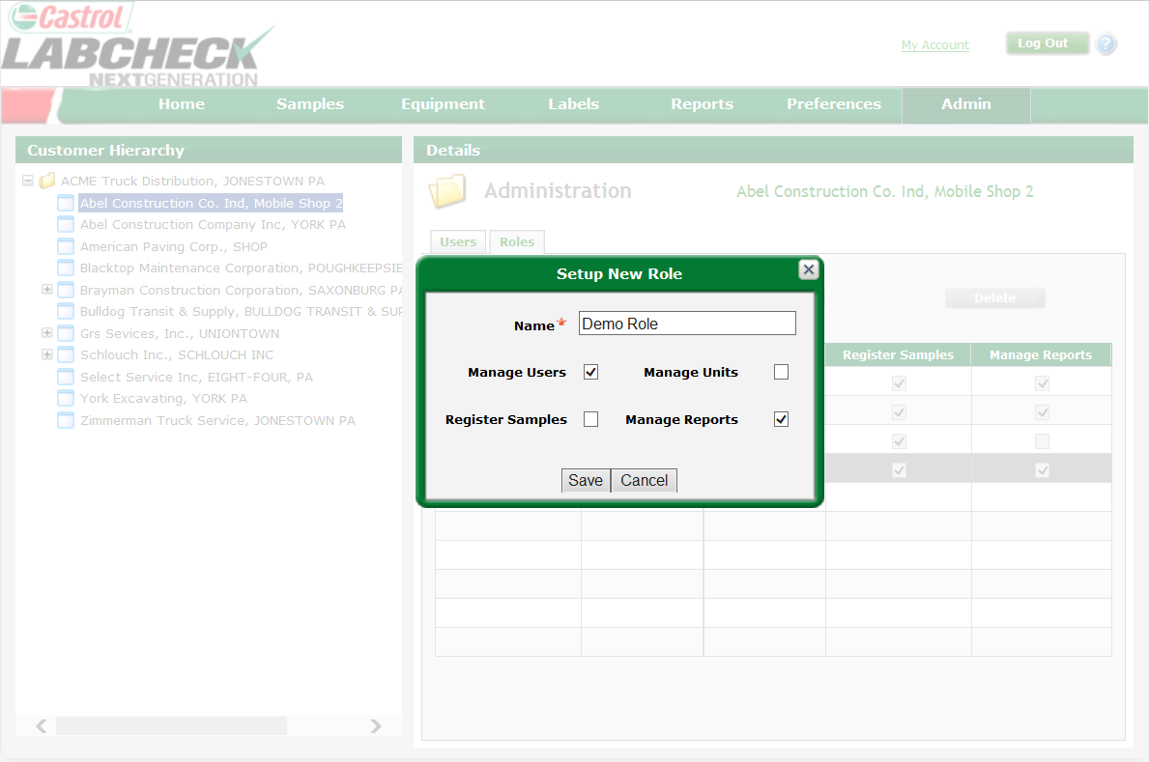
Creating Custom Roles
When creating a customized role, users must assign the role a unique name
Select the permissions associated with the role
Click “Save” to create this new role

Slide 5
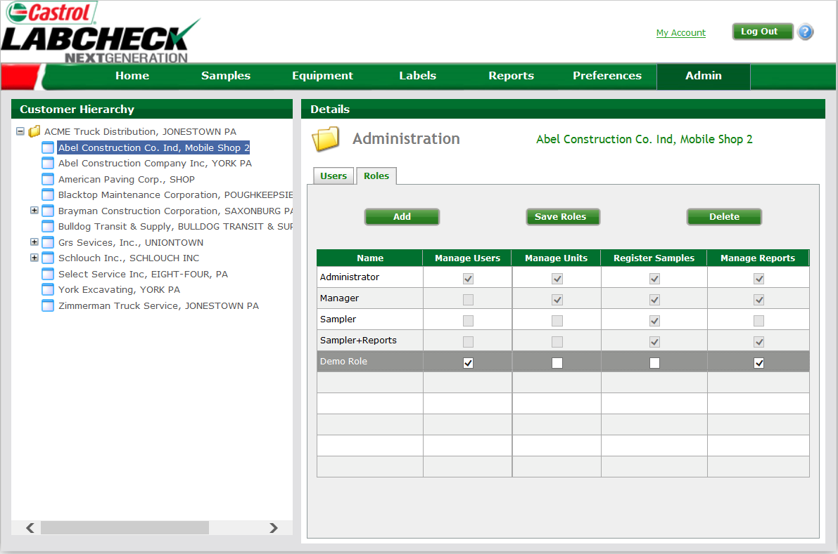
Modifying Roles
You can delete a role by selecting any of the non pre set roles and then selecting “Delete”
You can add as many roles to each worksite as needed by selecting “Add”
User-created roles can be customized from this screen by checking the additional permission levels and selecting “Save Roles”

